Slide 1
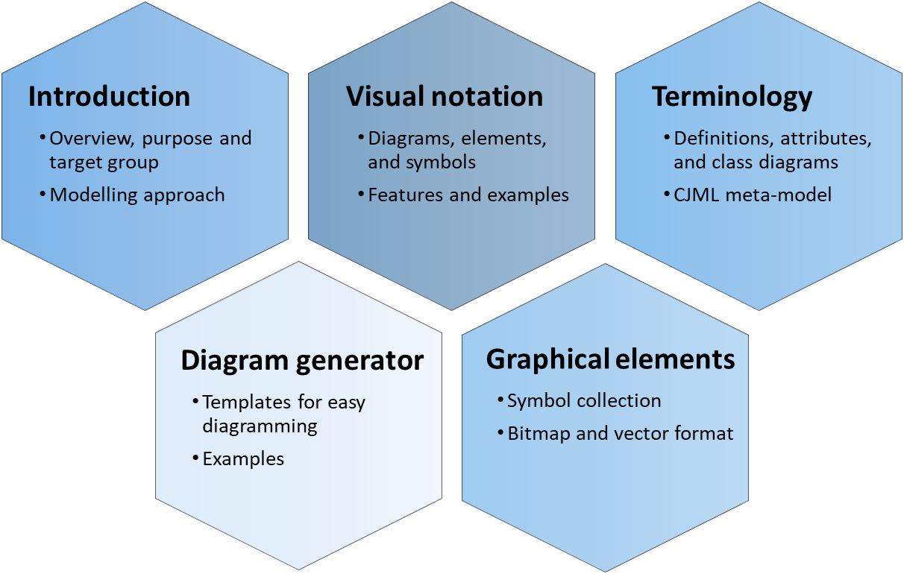

Terminology
CJML - Customer Journey Modelling Language
Version 1.1
SINTEF Digital | Software and service innovation
March 2021
Copyright © 2021 SINTEF

Slide 2




Overview of CJML resources
Introduction
Overview, purpose and target group
Modelling approach
Visual notation
Diagrams, elements, and symbols
Features and examples
Terminology
Definitions, attributes, and class diagrams
CJML meta-model
The CJML material consists of several documents that are to be seen in connection to each other. The material can be used separately, but we recommend to start with Introduction and overview.
Diagram generator
Templates for easy diagramming
Examples
Graphical elements
Symbol collection
Bitmap and vector format
All the CJML resources can be found here: www.sintef.no/cjml

Slide 3
Content
Readers guide
  Who can use this material?
  Additional resources
About the terminology
Terms
  Service (as a concept)
  Actor
  Service provider
  Customer/User
  Customer journey
  Journey phase
  Touchpoint
  Communication point
  Action
  Channel
  Object
  Symbol
  Concurrency
  Decision
CJML meta-model
  About the meta-model
  Meta-model
  Simplified meta-model
References

Slide 4
Who can use this material?
CJML v1.1 by SINTEF Digital is licensed under a Creative Commons Attribution-ShareAlike 4.0 International License.
Anyone can use, copy, and transform the material in any medium or format – for any purpose – under the following terms:
  Attribution: You must give appropriate credit, provide a link to the license, and indicate if changes were made
  ShareAlike: If you remix, transform, or build upon the material, you must distribute your contributions under the same license as the original.
Guidance on how to give appropriate credit can be found here:
https://creativecommons.org/use-remix/
https://wiki.creativecommons.org/wiki/Best_practices_for_attribution

Slide 5
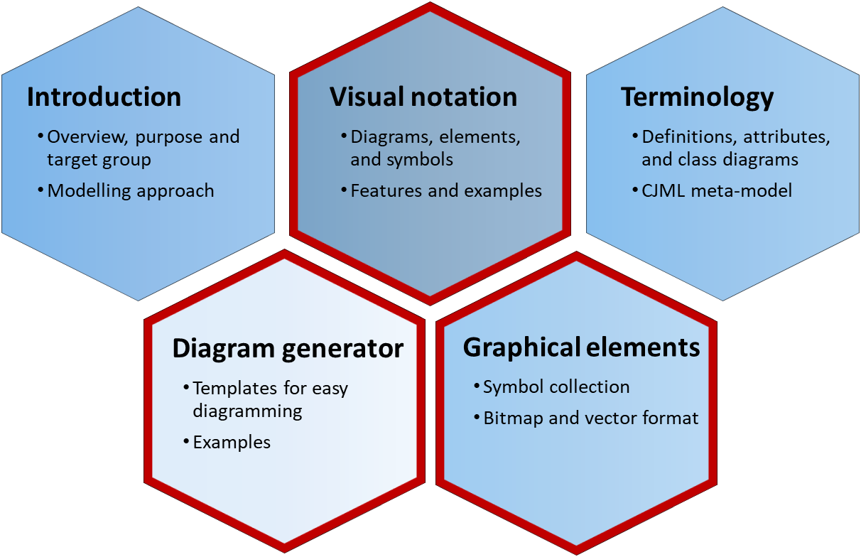
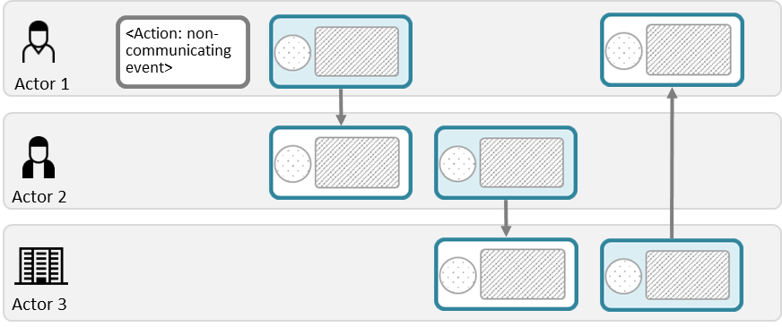
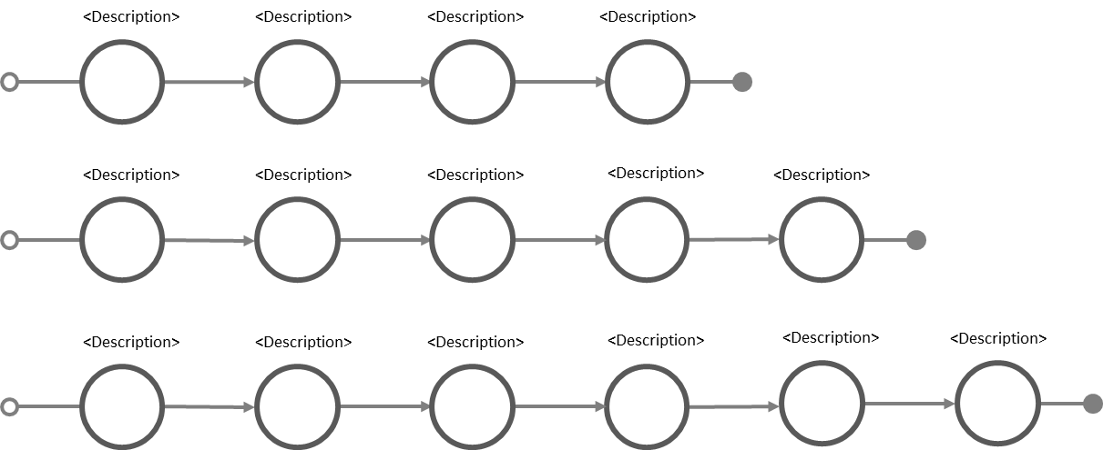
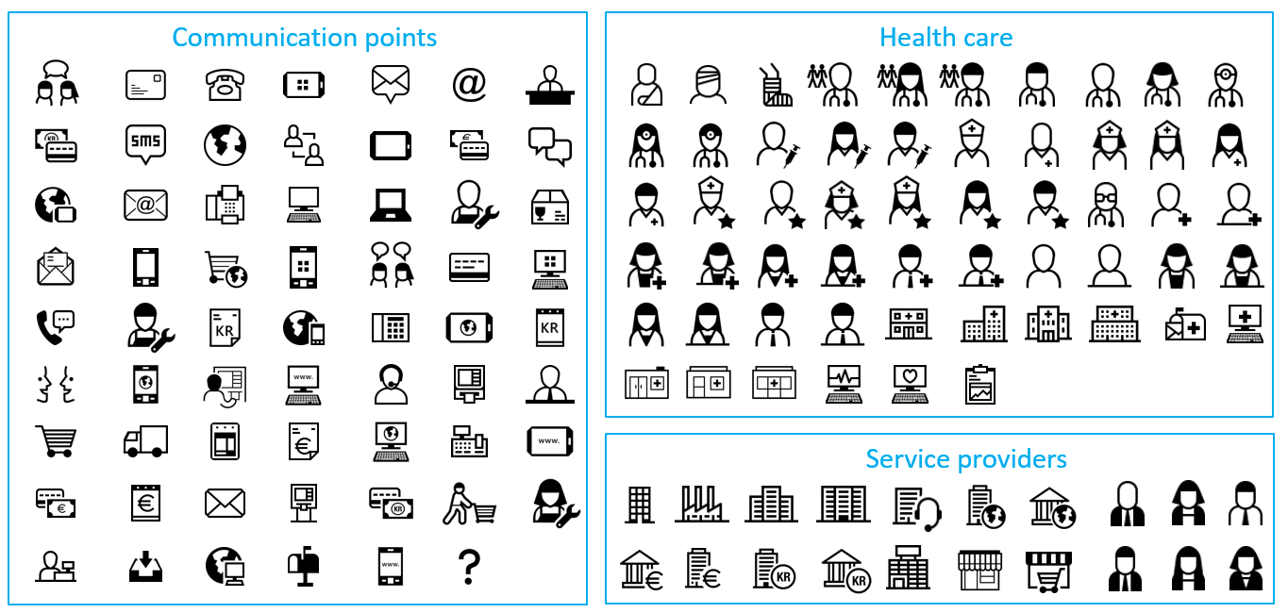
Additional CJML resources
For more information and publications based on CJML, please visit the web resource page: www.sintef.no/cjml
For help creating diagrams:
  Try our Diagram generator
  Alternatively, simply copy-paste elements from the Visual notation slides and modify for your own use.
  You can also download graphical elements in bitmap format (png) or vector format (svg)
  The former project site contains blog articles and stencils for Visio and Omnigraffle, see www.visualproject.org (not updated after 2016)
These modules contain support for making diagrams
Templates
Symbol gallery

Slide 6
About the terminology
Each term is defined in a table, and is accompanied by an illustrative subset of the meta-model
Some definitions are new while others are adopted from the literature
The field "Synonym" lists terms identified in the literature describing similar elements.
The meta-model is graphically described using the UML class diagram representation.

Slide 7
Terms

Slide 8
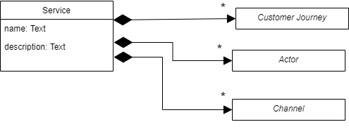
Service (as a concept)
Definition & source | An activity or series of activities of a more or less intangible nature that normally, but not necessarily, take place in the interaction between the customer and service employees and/or physical resources or goods and/or systems of the service providers, which are provided as responses to customer needs. This definition is a modified version based on definitions by Edvardsson, Gustafsson and Roos (2005) referring to Grönroos (2001)
Note | The definition of the term service is strongly debated in the academic literature, and several conflicting opinions exists.

Slide 9
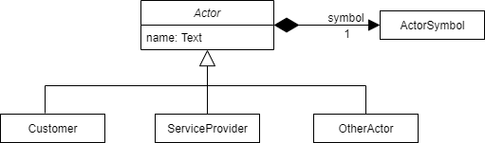
Actor
Definition & source | Any person (or entity) who is involved in the service delivery or service consumption
Note | As a minimum, there should be one customer and one service provider. There may also be more than one end-user and more than one service provider involved. Each actor is represented by a symbol in the visual notation.

Slide 10
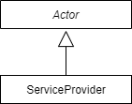
Service provider
Definition & source | A company or organisation that provides services to customers. Source: VISUAL, inspired by Wikipedia definition: https://en.wikipedia.org/wiki/Service_provider

Slide 11
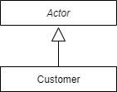
Customer
Definition & source | The person, group of persons, or organization, receiving the outcome of a service. This definition is adopted from Edvardsson and Olsson (1996). The synonyms below may substitute "Customer", depending on the service context (e.g. commercial service, public service, C2C service, B2C service).
Synonyms | Consumer, user, end-user, citizen, patient, human

Slide 12
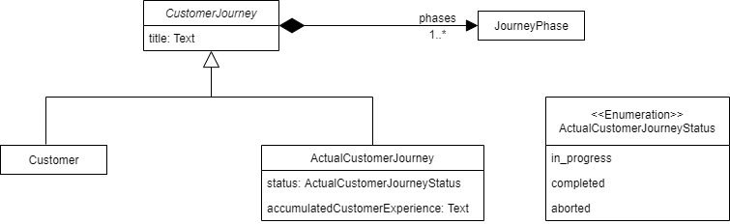
Customer journey
Definition & source | A sequence or constellation of touchpoints involved for a customer to achieve a specific goal or a desired outcome in the context of a service process
Note | The term is generally used as a metaphor for "a walk in the customer shoes" (Holmlid & Evensson, 2008)
Synonyms | service encounter, service process, customer path
Derived types | Planned customer journey: A planned journey is the customer journey as prescribed by the service provider(s) involved. Planned journeys corresponds to the potential state of Shostack's model (1982) Actual customer journey: is the real journey as experienced by a customer. Actual journeys correspond to the kinetic state of Shostack's model (1982) Status: In progress, completed or aborted

Slide 13
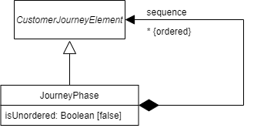
Journey phase
Definition & source | A temporal subunit of a customer journey.
Note | Koivisto (2011) use the term service moment, structured around actions that are logically connected. The journey phase in CJML may be any subunit of the journey.
Attributes | Is Unordered: An unordered journey phase is a group of customer journey elements that may occur in any order or in a random fashion.

Slide 14
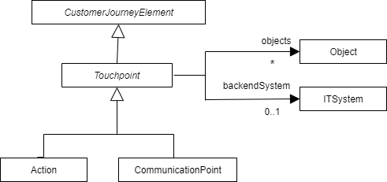
Touchpoint
Definition & source | An event or step in the customer journey.
Synonyms | Contact point, episode, incidents, service encounter, interaction point, moment of truth, service touchpoint, service contact
Attributes | DESCRIPTION – Textual description of the touchpoint STATUS — Planned, completed, missing, failing or ad hoc. ARBITRARILY OCCURRING – TRUE if the touchpoint occur at an arbitrary time within it's journey phase TIME ORIGINATED – The time it originated TIME AVAILABLE – The time it reached target (optional) TIME CONSUMED – The time it was encountered by target (optional) DURATION – The time duration of the touchpoint (optional) EXPERIENCE DESCRIPTION — Customers own descriptions of their experience with the touchpoint, in the form of textual description collected for example through interviews or surveys. (optional) EXPERIENCE RATING — Satisfaction measure e.g. on a 5-point Likert scale. (optional)
Relationships | OBJECTS (OBJECT) – Associated objects (optional, zero to many) BACKEND SYSTEM (IT SYSTEM) – The backend system that processed the touchpoint. (optional)

Slide 15
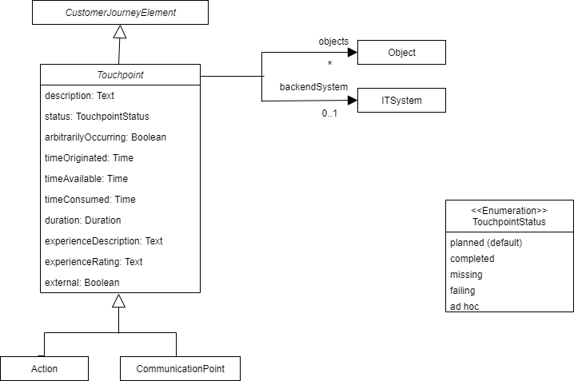
Touchpoint

Slide 16
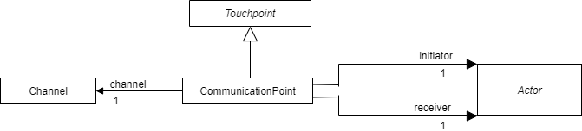
Communication point
Definition & source | Instance of communication or interaction between a customer and a service provider.
Synonyms | Contact point, episode, incidents, service encounter, interaction point, moment of truth, service touchpoint, service contact
Attributes | Contains the touchpoint attributes
Relationships | INITIATOR (actor) RECEIVER (actor) CHANNEL (the channel used)

Slide 17
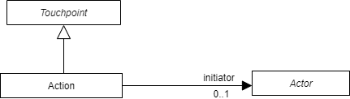
Action
Definition & source | An event or activity conducted by the customer or the service provider as part of a customer journey.
Synonyms | Event, process step, activity
Note | An action do not involve direct communication, in contrast to a communication point. Example to distinguish communication points and actions: Communication point: notification for meter reading Action: reading the meter Communication point: reporting the meter
Attributes | In addition to the touchpoint attributes
Relationships | INITIATOR (actor, optional)

Slide 18

Channel
Definition & source | A service provider's means of communicating or interacting with its customers (Osterwalder 2004)
Synonyms | Distribution channel, customer channel, service interface

Slide 19
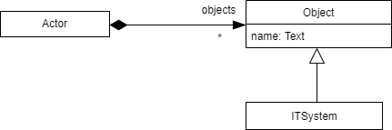
Object
Definition & source | A physical item that is made available for the customer as part of a customer journey. It also comprise IT-systems that are parts of the service system.
Synonyms
Notes | An object belongs to a service actor.

Slide 20
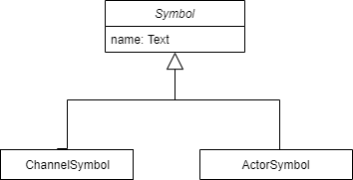
Symbol

Slide 21
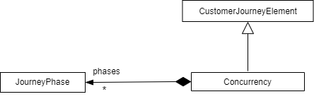
Concurrency

Slide 22
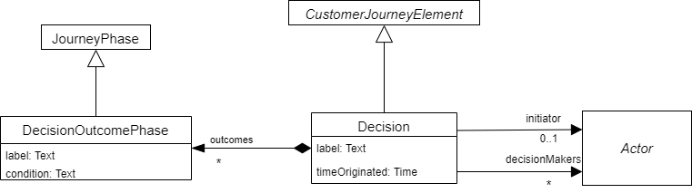
Decision

Slide 23
CJML Meta-model
About the meta-model
Meta-model
Simplified meta-model

Slide 24
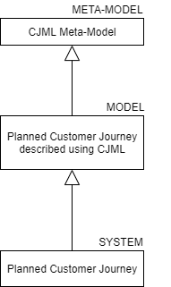
About the meta-model
What is a meta-model?
  A meta-model is "a model of a modelling language ". It describes the structure, semantics and constraints of a model (Mellor, 2004).
  A meta-model illustrates a higher level of abstraction than the modelling language itself
  It describes the structure, semantics and constraints of a language
Why do we use meta-model?
  The use of a meta-model makes language definitions easier to understand and the definitions can possibly be integrated and manipulated in the same way as system models (Evans et al., 2003).
  Meta-models offer the facilities which support the design of models (Akehurst and Patrascoiu, 2003).
Examples of meta-modelling language
  UML (Unified Modelling Language)
  SysML (Systems Modeling Language)
An example of a planned customer journey abstraction

Slide 25
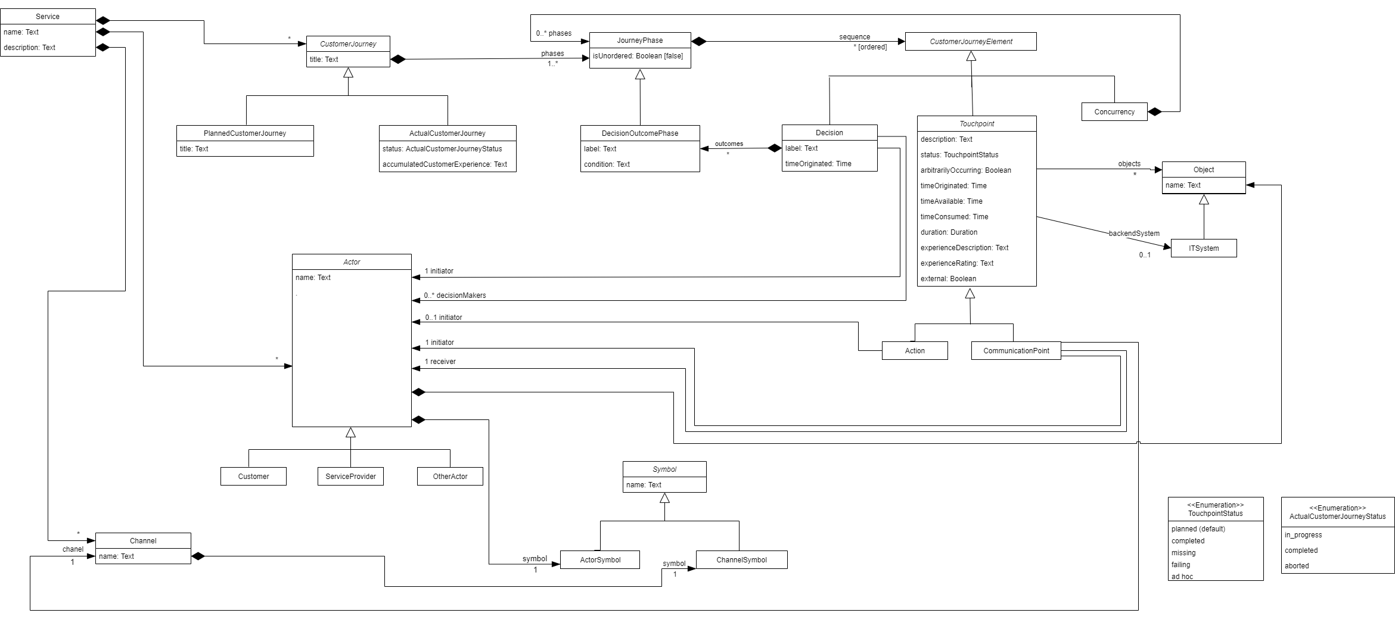
CJML metamodel

Slide 26
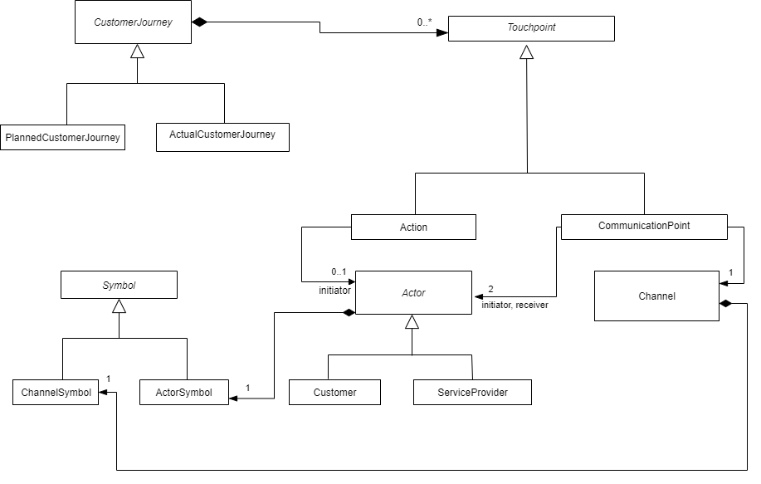
CJML simplified metamodel

Slide 27
References
Akehurst, D.H. and Patrascoiu, O. (2003). Tooling metamodels with patterns and OCL, in: Proceedings from the workshop Metamodelling for MDA, York, UK, pp. 203-215.
Edvardsson, B. and J. Olsson (1996). Key concepts for new service development. Service Industries Journal 16(2), 140-164.
Edvardsson, B., Gustafsson, A. and Roos, I. (2005). Service portraits in service research: a critical review. Int. J. Serv. Ind. Manag. 16, 107–121.
Evans, A., Sammut, P. and Willans, J.S. (2003). Metamodelling for MDA, in: Proceedings from the workshop Metamodelling for MDA, York, UK, pp. 1-8.
Grönroos, C. (2001). Service management and marketing. Wiley New York NY.
Holmlid, S. and Evenson, S. (2008). Bringing Service Design to Service Sciences, Management and Engineering. In Service Science, Management and Engineering Education for the 21st Century: Springer, 341-5.
Koivisto, M. (2009). Frameworks for structuring services and customer experiences. In S. Miettinen & M. Koivisto (Eds.), Designing Services with Innovative Methods (pp. 136-149). Helsinki: University of Art and Design, Helsinki.
Mellor, S.J. (2004). MDA distilled: principles of model-driven architecture. Addison-Wesley Professional.
Osterwalder, A. (2004). The business model ontology: A proposition in a design science approach. PhD thesis. University of Lausanne, Ecole des Hautes Etudes Commerciales, Switzerland.
Shostack, G. L. (1982). How to design a service. European Journal of Marketing, 16(1), 49-63.
Stickdorn, M. and J. Schneider (2011). This is service design thinking. Amsterdam, BIS Publishers.

