Slide 1
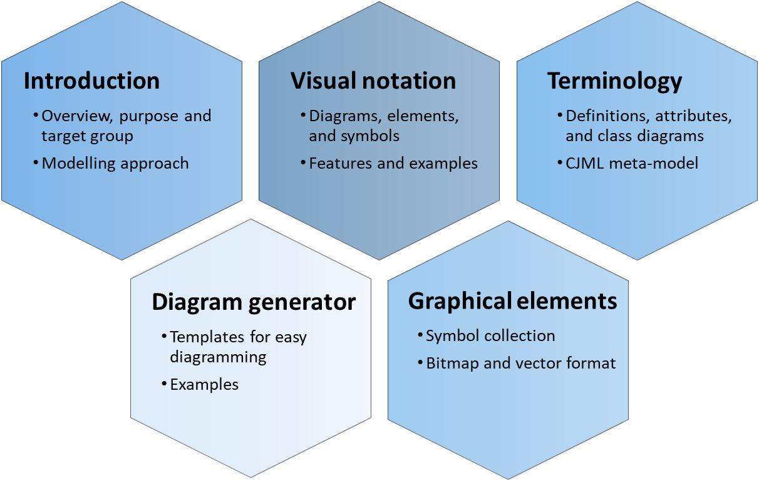

Diagram generator
CJML - Customer Journey Modelling Language
Version 1.1
SINTEF Digital | Software and service innovation
March 2021
Copyright © 2021 SINTEF

Slide 2




Overview of CJML resources
Introduction
Overview, purpose and target group
Modelling approach
Visual notation
Diagrams, elements, and symbols
Features and examples
Terminology
Definitions, attributes, and class diagrams
CJML meta-model
The CJML material consists of several documents that are to be seen in connection to each other. The material can be used separately, but we recommend to start with Introduction and overview.
Diagram generator
Templates for easy diagramming
Examples
Graphical elements
Symbol collection
Bitmap and vector format
All the CJML resources can be found here: www.sintef.no/cjml

Slide 3
Content
Readers guide
  Who can use this material?
  Additional resources
Overview
  Representation of basic attributes
  Diagram types and comparison
  Elements - journey diagram
  Elements - swimlane diagram
Templates
  Journey diagram
  Swimlane diagram
Examples
  Journey diagram
  Swimlane diagram

Slide 4
Who can use this material?
CJML v1.1 by SINTEF Digital is licensed under a Creative Commons Attribution-ShareAlike 4.0 International License.
Anyone can use, copy, and transform the material in any medium or format – for any purpose – under the following terms:
  Attribution: You must give appropriate credit, provide a link to the license, and indicate if changes were made
  ShareAlike: If you remix, transform, or build upon the material, you must distribute your contributions under the same license as the original.
Guidance on how to give appropriate credit can be found here:
https://creativecommons.org/use-remix/
https://wiki.creativecommons.org/wiki/Best_practices_for_attribution

Slide 5
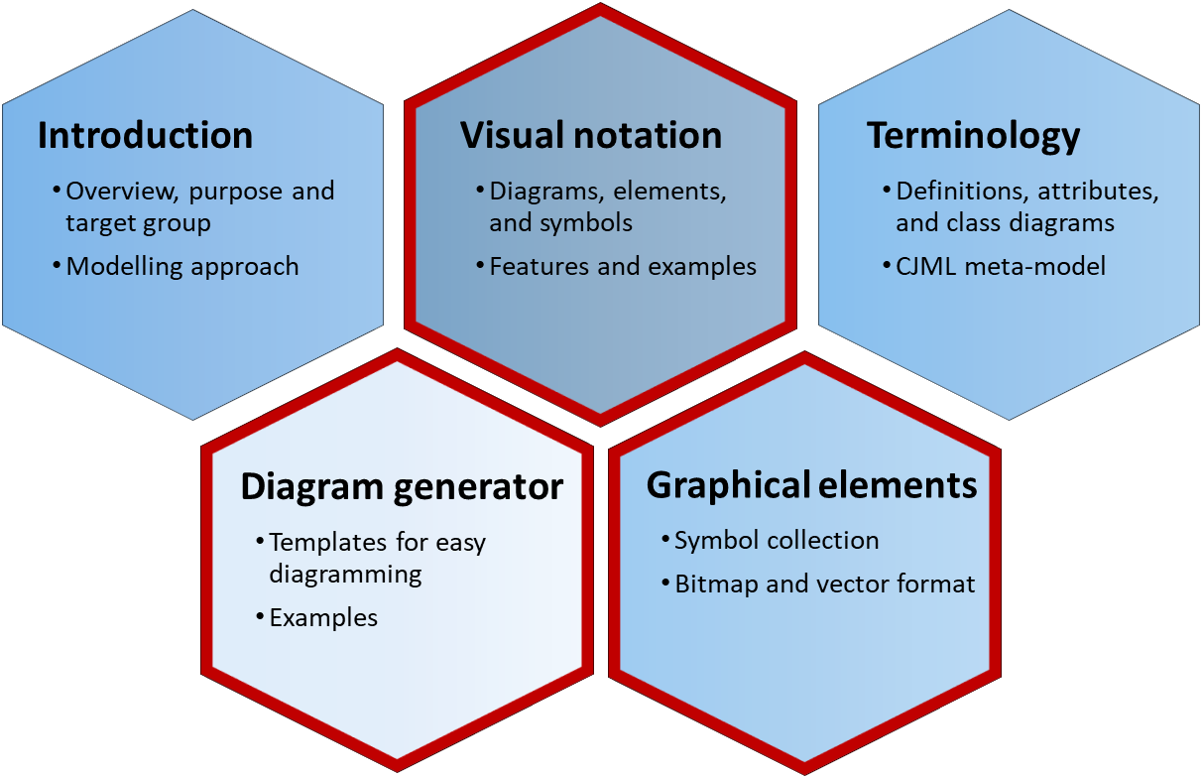
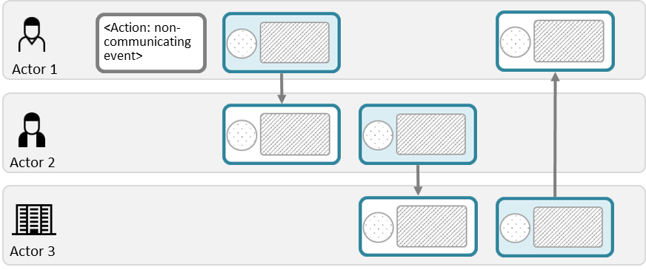
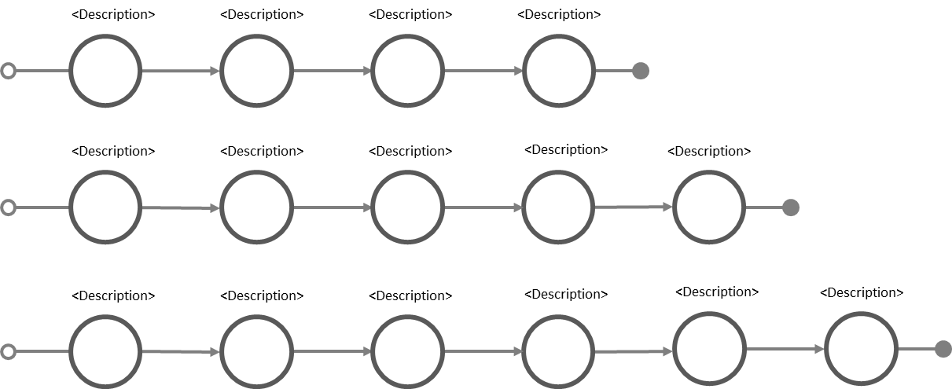
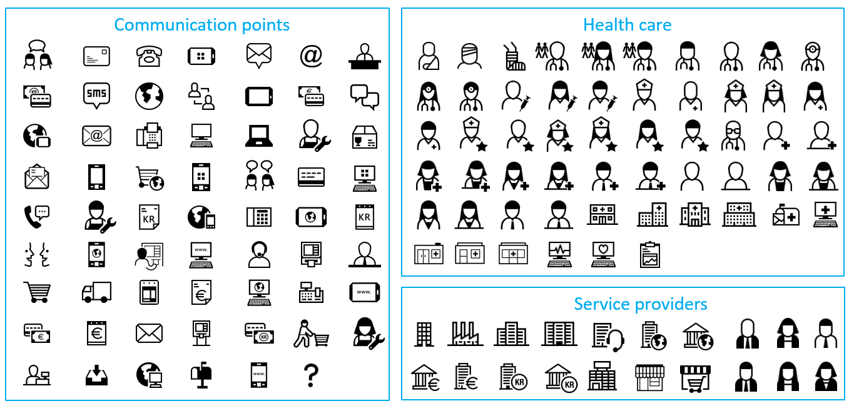
Additional CJML resources
For more information and publications based on CJML, please visit the web resource page: www.sintef.no/cjml
For help creating diagrams:
  Try our Diagram generator
  Alternatively, simply copy-paste elements from the Visual notation slides and modify for your own use.
  You can also download graphical elements in bitmap format (png) or vector format (svg)
  The former project site contains blog articles and stencils for Visio and Omnigraffle, see www.visualproject.org (not updated after 2016)
These modules contain support for making diagrams
Templates
Symbol gallery

Slide 6
Overview
Representation of basic attributes
Diagram types and comparison
Elements - journey diagram
Elements - swimlane diagram

Slide 7
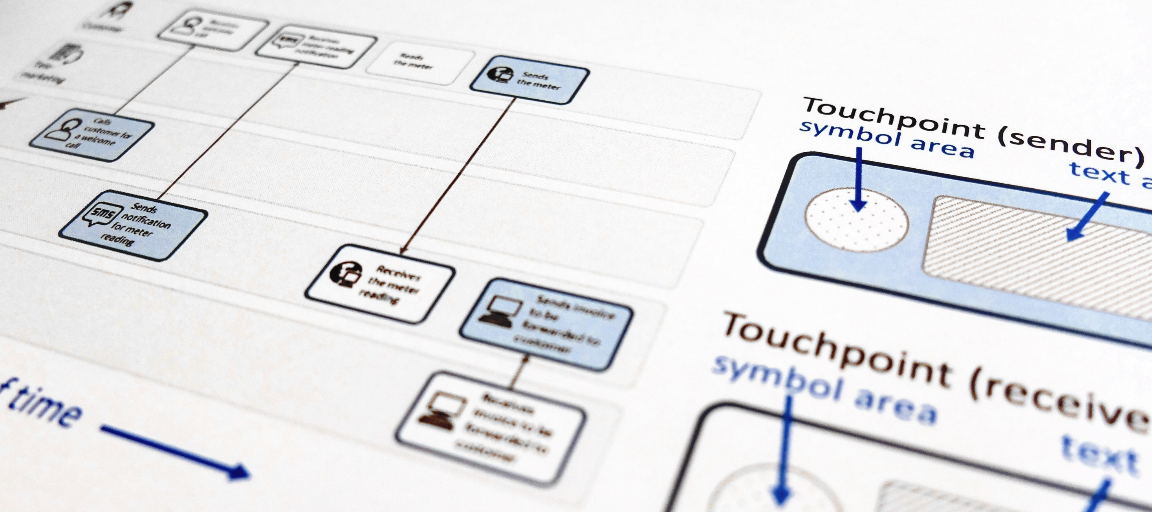
CJML - Customer Journey Modelling Language
CJML is a visual language dedicated to modelling of customer journeys, human behaviour and digital service processes
Customer journey
User journey
Employee journey
Patient journey
Citizen journey

Slide 8
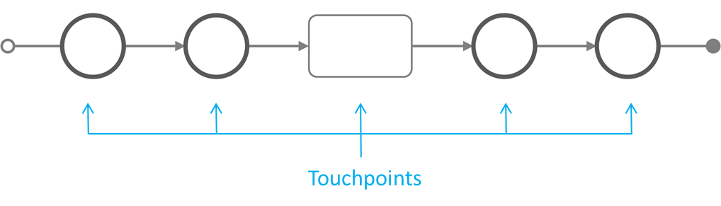
The CJML language
CJML is a formal language for specification and visualization of customer journeys and service processes.
CJML is centred around humans and human activities, regardless of their role being a customer, user, citizen, consumer, patient, or employee.
Customer journeys are modelled as sequences or constellations of touchpoints for a customer to achieve a specific goal or outcome.
CJML consists of terminology, diagrams, methods and tools.
Communication points are instances of communication or interaction between a user and a service provider
Actions are non-communicative events or activities conducted by an actor as part of a customer journey
The scope of a journey should be defined in relation to the purpose of the study.
Customer journey

Slide 9


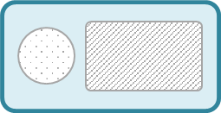
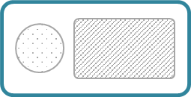
Representation of basic attributes
CJML offers two ways to represent a communication point, corresponding to two distinct diagram types
The figure illustrates how the representation changes in accordance to the direction of the communication.
From Actor 1 to Actor 2
From Actor 2 to Actor 1
Message
Message
Communication channel
Communication channel
Actor 1
(initiator)
Actor 2
(receiver)
Actor 1
(receiver)
Actor 2
(initiator)
REPRESENTATION 1
REPRESENTATION 2
REPRESENTATION 1
REPRESENTATION 2
Communication channel
Communication channel
text area
text area
Actor 1
(initiator)
Actor 1
(receiver)
direction
direction
Actor2
(receiver)
text area
Actor 2
(initiator)
text area

Slide 10

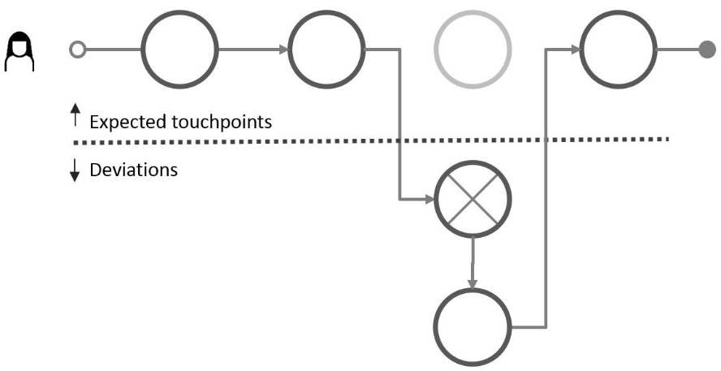
Overview - diagram types
The journey diagram has many visual features, however the swimlane diagram enables a better overview of the service delivery network.
Journey diagram
Suitable for planned and actual journeys with few actors involved
Suitable for actual journeys when emphasizing deviations from the planned journey
Swimlane diagram
Suitable when several actors are involved
Suitable for service delivery networks (see reference)
Reveals both the sender and the receiver of each communication point
Tax et al. (2013). The Service Delivery Network (SDN): A Customer-Centric Perspective of the Customer Journey. Journal of Service Research, 16(4), 454-470.
Note the difference in how a communication point is represented in the two diagrams.

Slide 11










Comparison of diagram types
Meets for an appointment with the GP
Receives information about the appointment
Receives an SMS reminder about
the appointment
Consultation with specialist at the
out-patient clinic
Journey diagram
(patient's journey)
Note that this journey corresponds to the elements in the patient's swimlane below.
Swimlane diagram
Meets for an appointment with GP
Receives information about the appointment
Receives an SMS reminder about the appointment
Consultation with specialist at the out-patient clinic
Patient
Medical examination => need to consult a specialist
Sending an electronic referral to the specialist
Note that this touchpoint is invisible for the patient (and thus not part of the patient's journey above)
GP
Receives the referral and decide to call in the patient
Schedules and issues a letter with information
Sends notification about the appointment
Examines the patient, decides for an operation
Specialist
Simplification: this stage involves several actors and steps which is not shown here.
Simplification: this is normally taken care of by a medical coordinator at the specialist's clinic
Comment

Slide 12



Journey diagram – basic elements
Choose colours for the various actors. A tradition in CJML is to use orange colour to represent a customer
Communication point boundary
Communication points are represented as a circle
The circle's boundary style carries information about
the actor initiating the touchpoint
the status of the touchpoint
The symbol in the middle represents the communication channel or the device being used
symbol area
The symbols are presented in a separate slide
Examples
Actor
The colour indicates the actor who initiates the communication point. Conventions
Orange is often reserved for a customer
Choice of colour should be consistent
If many actors are involved, a swimlane diagram may be more suitable
Customer
Service provider
Additional actor
Customer calls the service company
Service company sends an e-mail
Patient
Doctor
Patient meets for a medical consultation
Hospital sends a SMS reminder
Status
The boundary style indicates the status of the communication point
solid boundary: completed
dashed boundary: missing
crossed touchpoint: failing
Completed
Missing
only used for
actual journeys
Failing
only used for
actual journeys
Customer fails to buy a train ticket
Customer did not receive a call from the service company

Slide 13
Journey diagram - deviation
Planned journey
Actual journey
Expected touchpoints
Deviations

Slide 14





Swimlane diagram – basic elements
A communication point has a sender and a receiver that must be positioned in the corresponding swimlanes of the actors.
Action
Communication point
Communication point
Communication point
All the actors involved in the journey has a separate swimlane.
Sender
text area
Communication channel
direction
text area
Actor 1
Receiver
Actor 2
An action element is used for non-communicating events
Actor 3
Text area
Comment
Add an extra swimlane for comments if explanations are needed.

Slide 15
Templates – Journey diagrams

Slide 16
Journey diagram
Customer journey
User journey
Employee journey
Patient journey
Citizen journey
Identify the actor in focus, and choose a colour associated with the communication points initiated by the actor in focus. Also, choose a colour for the other actor(s).
Insert the actions and communication points and connect them. Insert appropriate symbols from the symbol gallery.
Alternatively, pick touchpoints with already-inserted symbols.
For actual journeys, insert the actor symbol in front
Communication point boundary
symbol area
<Description of the communication point>
<Description of the communication point>
<Description of the communication point>
<Description of
the action>
Action
Planned journey
<describe the action>
<Description of the communication point>
<Description of the communication point>
<Description of the communication point>
<Description of
the action>
Actual journey

Slide 17
Journey diagram
<Description>
<Description>
<Description>
<Description>
4 touchpoints
<Description>
<Description>
<Description>
<Description>
<Description>
5 touchpoints
<Description>
<Description>
<Description>
<Description>
<Description>
<Description>
6 touchpoints
<Description>
<Description>
<Description>
<Description>
<Description>
<Description>
<Description>
7 touchpoints

Slide 18


























































































































All symbols
Communication points
Actors - health care
Actors - service providers and employee
Actors
Customer experience

Slide 19








Touchpoints with symbols
Choose a colour for the initiator of the touchpoint.
Connect the touchpoints to form a journey.
More details can be found in the document describing the notation.
telephone conversation
self-service machine
SMS
internet via PC
e-mail
internet via tablet
social media interaction/message
internet via smartphone
letter
invoice
face-to-face interaction
payment

Slide 20















Touchpoints with symbols
Choose a colour for the initiator of the touchpoint.
Connect the touchpoints to form a journey.
More details can be found in the document describing the notation.
chat
message service
shopping
call centre
telephone
shop counter
globe/internet
fax
service desk
app on PC
PC
logistics
app on tablet
tablet
package
app on smartphone
smartphone
technician (visit)
online shopping
unknown channel/device

Slide 21
Templates – Swimlane diagrams

Slide 22
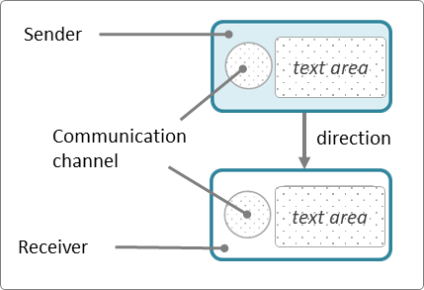

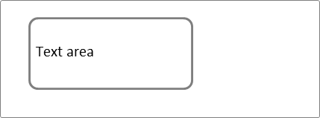

Swimlane diagram
Position each part of the communication point in the correct lane, insert text and symbol
Use an action element for non-communicating events
Identify the involved actors and find suitable icons to represent them in the symbol gallery. You may use the lower swimlane to explain details or to represent user experience, see the examples
<Actor 1>
<Actor 2>
<Actor 3>
Choose symbols from the symbol gallery and place them here
<Short text explaining the sending side>
Text
Text
Text
<describe the action>
<describe the action>
<Short text explaining the receiving side>
Text
Text
Text

Slide 23
Swimlane diagram – four actors
Actor 1
Actor 2
Actor 3
Actor 4
Text
Text
Text
Text
<describe the action>
<describe the action>
Text
Text
Text
Text

Slide 24
All symbols
Communication points
Actors - health care
Actors - service providers and employee
Actors
Customer experience

Slide 25
Special elements for deviations
Sender Receiver
A swimlane diagram can also be used to represent actual customer journeys with deviations from the planned journey.
The shape's boundary style carries information about its status, as illustrated to the right.
When it is important to outline deviations in relation to a planned journey, a customer journey deviation diagram may be more suitable.
Completed
Missing
Failing
Ad-hoc

Slide 26
Examples – Journey diagrams
Going to the movies – planned journey
Going to the movies – actual journey with deviation
Going to the movies – actual journey with deviation/failure
Going to the movies – actual journey with customer experience

Slide 27
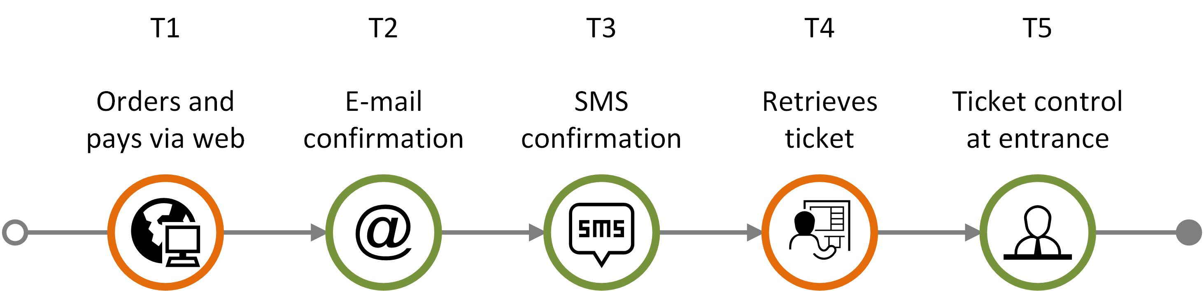
Going to the movies – planned journey
The journey encompass ordering and paying a movie ticket via web (T1), receiving a confirmation via e-mail (T2) and SMS (T3), then later retrieving ticket at a self-service machine at the movie theatre (T4), and finally showing the ticket at the entrance (T5).

Slide 28
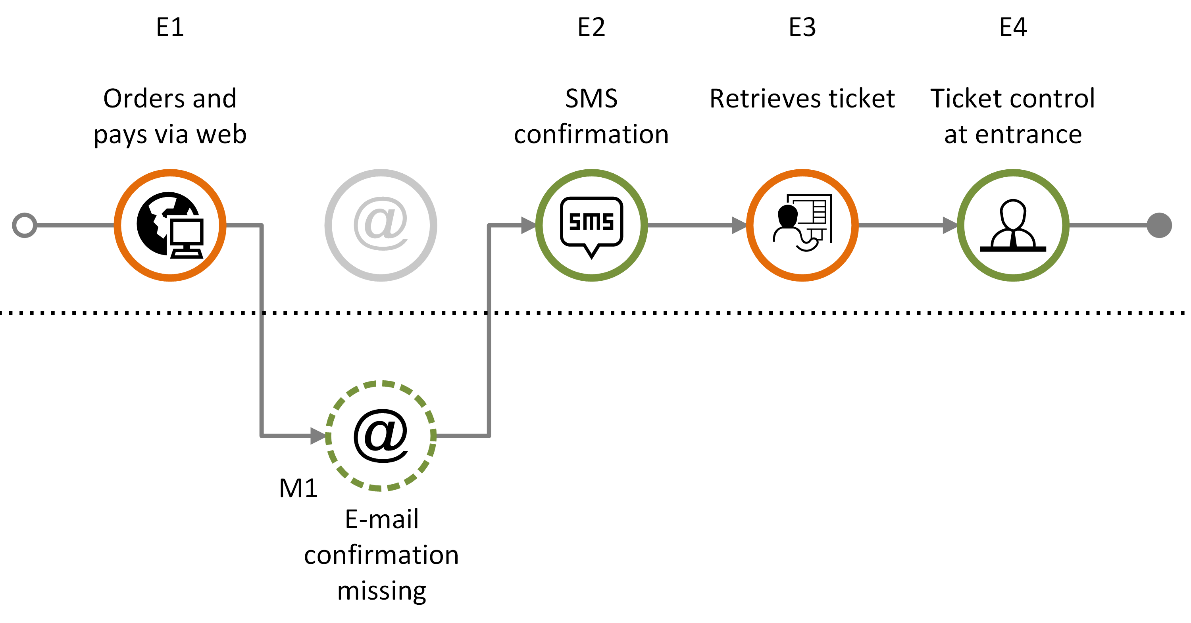
Going to the movies – actual journey 1
Customer journey consisting of a sequence of expected communication points (E1-E4) and with one missing communication point (M1).

Slide 29
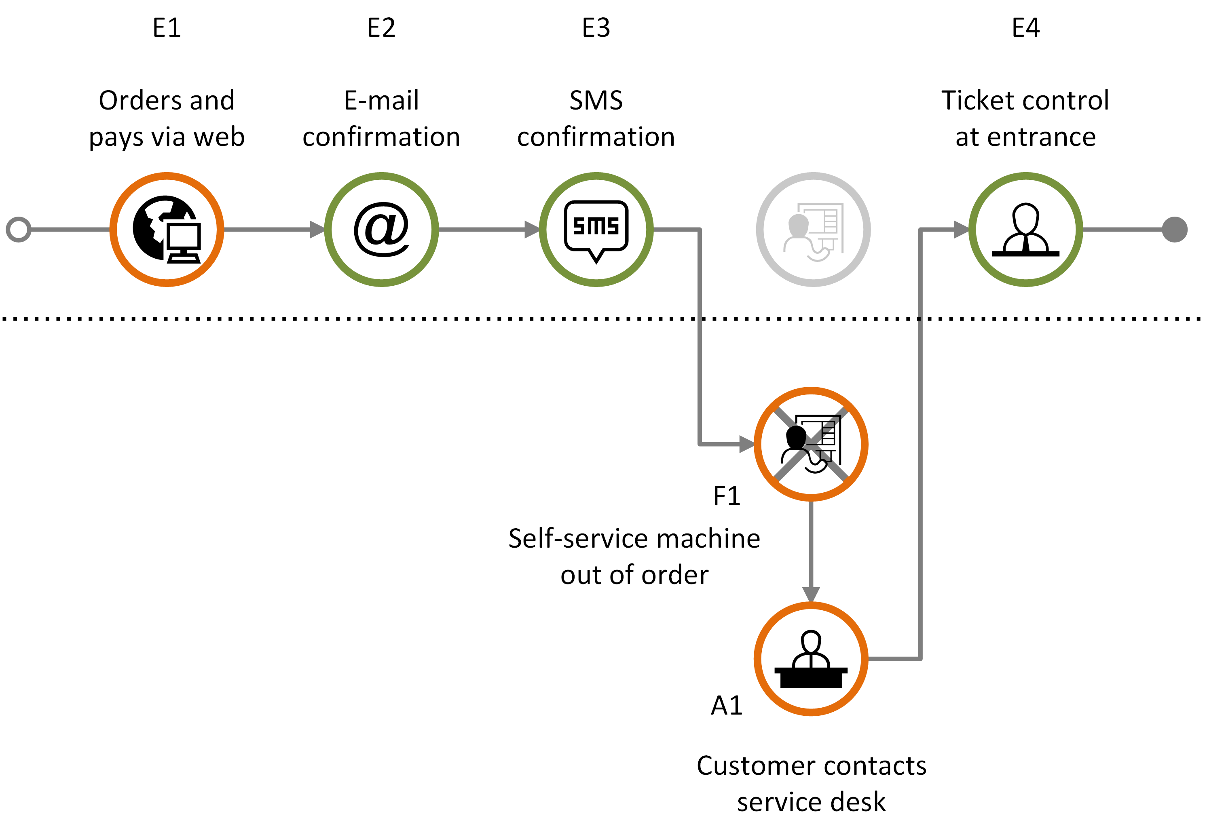
Going to the movies – actual journey 2
Customer journey consisting of expected communication points (E1-E4), with one failing communication point (F1) that in turn generates an ad-hoc communication point (A1).

Slide 30








Customer experience – callout
Customer experience collected from interviews, questionnaires, etc. can be visualized using simple callout containing customers' statements.
The example shows the use of callouts to express customer experience.
The customer experience symbol relates to how the customer has rated a touchpoint.
E1
E2
E3
E4
E5
order and pay ticket via web
e-mail confirmation
SMS confirmation
retrieve ticket
ticket control at entrance
It was easy to order the tickets. I just chose the movie I wanted to see, selected a seat, and put in my payment details.
Very satisfied
I don't understand why I get this information on SMS when I also received it on e-mail.
Unsatisfied
The queue for getting into the movie theatre was a bit long, but the person at the entrance was very friendly and helpful.
Satisfied

Slide 31
Examples – Swimlane diagrams
Health: A MS patient journey - part 1 and 2
Cyber security: Man-in-the-middle attack

Slide 32




Health: A MS patient journey – part 1
BOOKING OF APPOINTMENT
OUTPATIENT CLINIC
April 13th 1 p.m.
April 18th
April 27th
April 30th
I need to book a new appointment at the outpatient clinic, but it is already too late.
Calls the outpatient clinic to book an appointment.
Receives a reminder.
Meets at the outpatient clinic.
Sara
General practitioner
Neurologist
Allocates an hour on April 30th.
Sends a reminder.
Takes blood samples and administers infusion.
Nurse, MS clinic
Calling hours are from 8 -11 a.m. This is too limited. I would like to call after lunch time!
I could not have the time that suited me best.
A reminder with date, time, building and link to exact location.
I met a new nurse. He was skilled and very friendly.
The patient's experience is represented in a separate swimlane.
Sara's experience

Slide 33

Health: A MS patient journey - part 2
    BOOKING OF NEXT APPOINTMENT
May 8th
May 9th
May 9th
May 9th
Visits a MS web resource page with research news.
I realize that it's time to book a new appointment for infusion.
Can't get through to call centre.
Calls the outpatient clinic to book next appointment
for infusion.
Sara
General practitioner
Neurologist
(Telephone system not open)
Reserves an appointment
on May 31st.
Nurse, MS clinic
Reads about a new promising medicine.
Met an answering machine saying it was outside calling hours (not true)!
Finally – got an appointment on the day I wanted.
The patient's experience is represented in a separate swimlane.
Sara's experience

Slide 34








Cyber security: Man-in-the-middle attack
Eric works in a SME developing e-health systems as a customer consultant. Cindy, a general practitioner, has problems when uploading patient health records. Eric has brought his laptop to a coffee shop and unknowingly connects via a fraudster WiFi-connection. Eric's login credentials to the e-health system is intercepted by the attacker.
E
Eric visits the local coffee shop and unknowingly connects his laptop via the fraudster WiFi network.
He receives the call and asks for system logs and error messages.
He receives the system logs and error messages.
He logs into the EHR system to reconfigure the user account.
Eric explains the error and confirms that it is solved.
Eric (consultant)
The user account is now configured correctly.
EHR system
Cindy has problems when synchronising new patient information in the EHR system.
She calls Eric, her regular consultant, to solve the problem.
She sends system logs and error messages.
Cindy receives a confirmation that the problem is solved.
Cindy (customer)
In a coffee shop, Eve has set up a fraudster WiFi connection with a legitimate sounding SSID
Eve intercepts the message received by Eric.
Eve intercepts Eric's login credentials.
Eve (attacker)

