Slide 1
Energy Efficiency – Research Center
Knowledge - Friendship - Teamwork

Slide 2
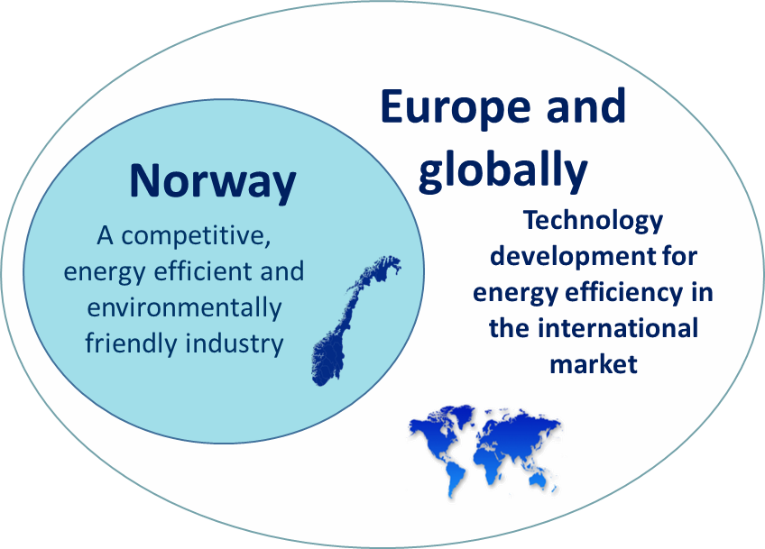
HighEFF Vision
Joint effort for creating a competitive, energy efficient and environmental friendly industry for the future

Slide 3
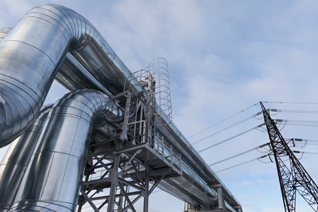
HighEFF
Largest effort in supporting research, development and innovation
To structure the research
39 partners
2016-2024
23 PhD / Post docs
395 MNOK
20-30 % reduction in specific energy use
10 % reduction in greenhouse gas emissions

Slide 4
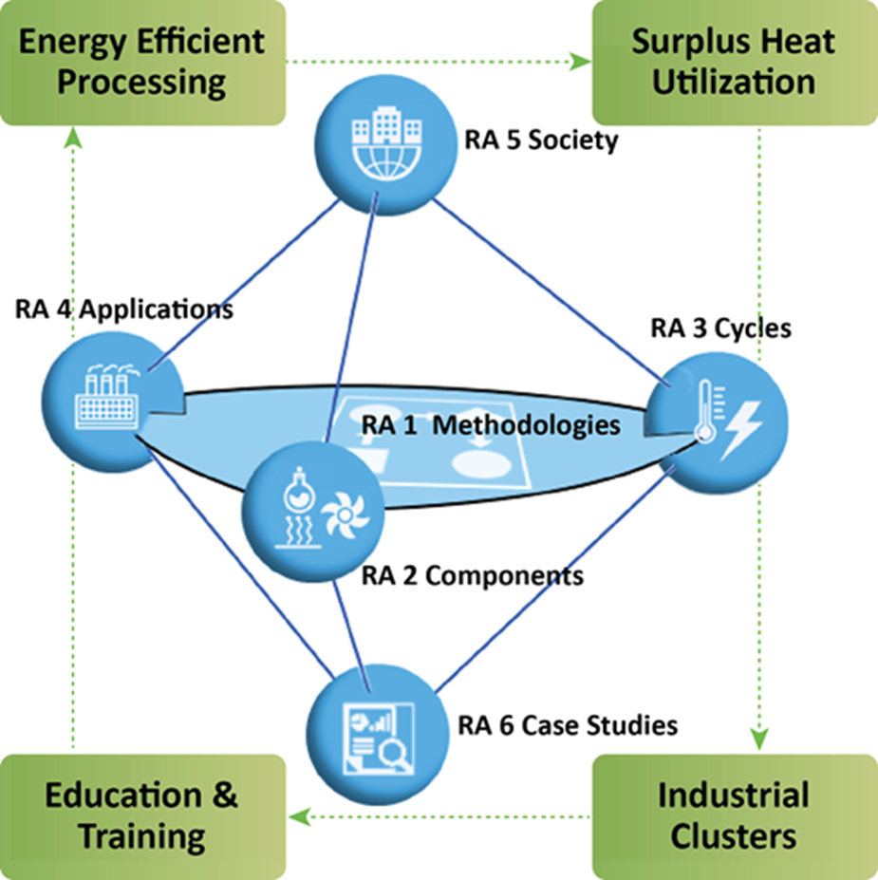
Focus in HighEFF
Corner Stones:
Energy Efficient Processing
Surplus Heat Utilization
Industrial Clusters
Education and Training
Research Areas:
Methodologies
Components
Cycles
Applications
Society
Case Studies

Slide 5
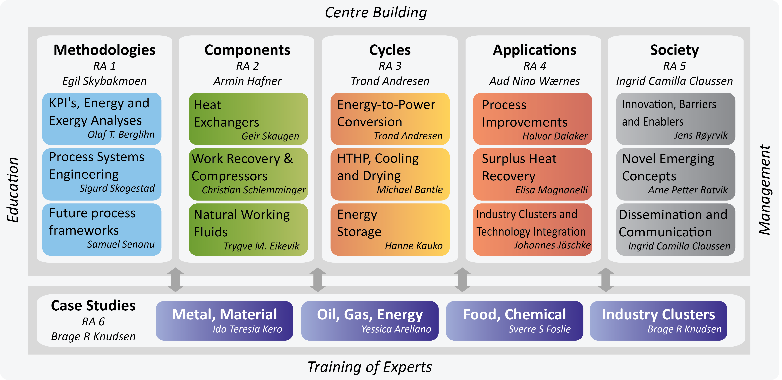
WBS

Slide 6
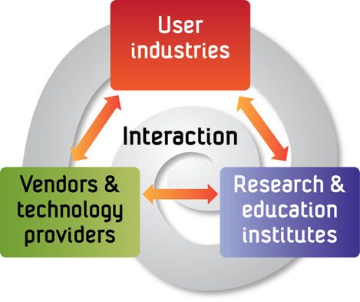
Equinor Energy AS
Hydro Aluminium AS
Rema 1000 i Norge AS
Eramet Norway AS
Norsk Alcoa AS
Elkem AS
Mo Industripark AS
Gassco AS
Orkla AS
Glencore Nikkelverk ASA
TINE SA
Pelagia AS
TripleNine Vedde AS
Wacker Chemicals Norway AS
Finnfjord AS
Borregaard AS
SINTEF Energi
Norges teknisk-naturvitenskapelige universitet, NTNU
SINTEF AS (SINTEF Industri)
NTNU Samfunnsforskning
Nord Universitet
SINTEF Ocean
Danfoss A/S
Alfa Laval Corp AB
EPCON AS
Officine Mario Dorin
GE Power Norway AS
Parat Halvorsen AS
Kungliga Tekniska Högskolan, KTH
Massachusets Institute of Technology
Carnegie Mellon University
The University of Manchester
Shanghai Jiao Tong University
AIT Austrian Institute of Technology
Doshisha University
Mayekawa MFG Co., Ltd
Hybrid Energy AS
Cadio AS
Gether AS
Enablers
ENOVA
Innovasjon Norge

