Slide 2
CINELDI is one of the Centres for Environment-friendly Energy Research in Norway (FME)
Technology-oriented FME centres
Social science-related FME centres
Notes:
The scheme is the most prominent tool for long term energy research in Norway.
The research activity is carried out in close cooperation between prominent research communities and users.
The main objective of the Centres for Environment-friendly Energy Research are:
to conduct concentrated, focused research of high international calibre in order to solve specific challenges in the energy sector in Norway, and
to promote innovations and industrial development.
Typical budgets: 300 – 400 mill NOK (30 – 40 mill €) over eight years with 50 % funding from the Research Council of Norway

Slide 3
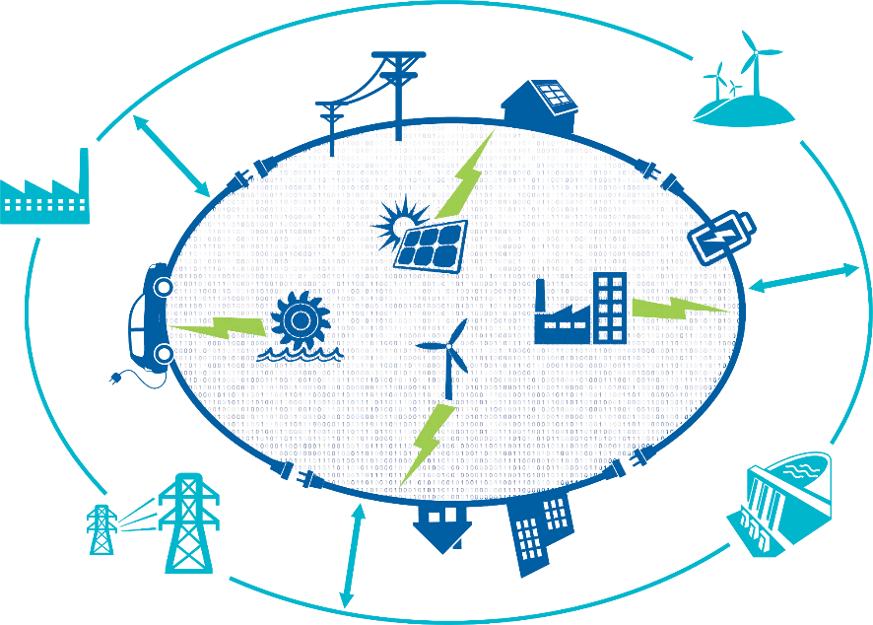
CINELDI develops the electricity grid of the future
Notes:
CINELDI Vision
CINELDI develops the electricity grid of the future.

Slide 4
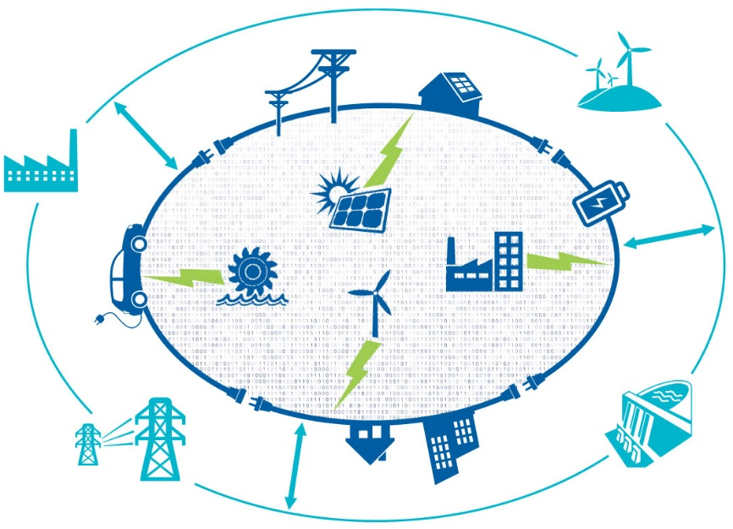
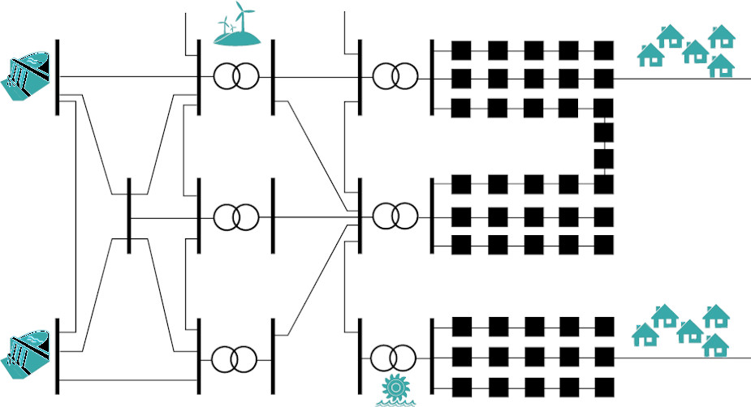
CINELDI facilitates the transition to the future flexible, intelligent and robust distribution grid
The current power system
The future power system
Power flow direction
Flow in both directions

Slide 5
CINELDI Mission
CINELDI works towards digitalising and modernising the electricity distribution grid for higher efficiency, flexibility and resilience.

Slide 6
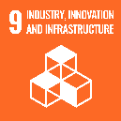
CINELDIs Main goal: a sustainable grid
Economy
To enable and facilitate a cost-efficient realisation of the future flexible and robust electricity distribution grid.
Security of supply
Environment
Notes:
Providing electricity with a high security of supply, which is also affordable, while at the same time ensuring the environmental goals, is often termed the energy trilemma, as these three goals are partly contradicting.
Economy/cost-efficient grid
CINELDI shall be an enabler and a facilitator for a socio-economic, cost-efficient realisation of the future flexible and robust electricity distribution grid and reduce the total distribution system costs compared to the "business as usual"-solutions by reducing operational (OPEX) and investment costs (CAPEX).
Security of supply
CINELDI will develop knowledge and methods needed to ensure the security of electricity supply, comprising the energy availability, power capacity, reliability of supply and voltage quality, as well as the cyber security, safety and privacy – as important parts of developing the electricity grid of the future.
Environmentally friendly grid
CINELDI will pave the way for increased distributed generation from renewable energy sources, electrification of transport and efficient use of electric power and energy.

Slide 7
CINELDI Main Deliverables (1)
Decision support methodologies and tools needed for the optimal planning and asset management of the future system.
New cost-effective concepts and solutions for smart operations based on new emerging control and monitoring technologies and extensive real time monitoring.
Methods and models for cost-effective integration of flexible resources in smart distribution grids, including business models on how to utilise this flexibility.
New concepts and solutions for utilising flexible resources in ancillary services and for increased observability between the distribution and transmission systems
Microgrid concepts, technologies and solutions for optimal design, operation, and integration with the distribution system.
Roadmap and recommendations for the transition to the intelligent electricity distribution system of 2030-2040 in Norway.

Slide 8
CINELDI Main Deliverables (2)
Knowledge base for grid owners and public authorities
Training researchers and master students and transfer expertise to industrial stakeholders
Efficient knowledge transfer through goal-oriented communication and user-involvement
Facilitate business opportunities for technology providers by knowledge transfer
Innovation opportunities for DSOs and TSO.

Slide 9
Scenarios for the future distribution grid
Digitalised grid
Passive customers
Automated grid
Flexible and intelligent grid
Active customers
Business
as usual
Distribution grid as
back-up
Analogous grid

Slide 10
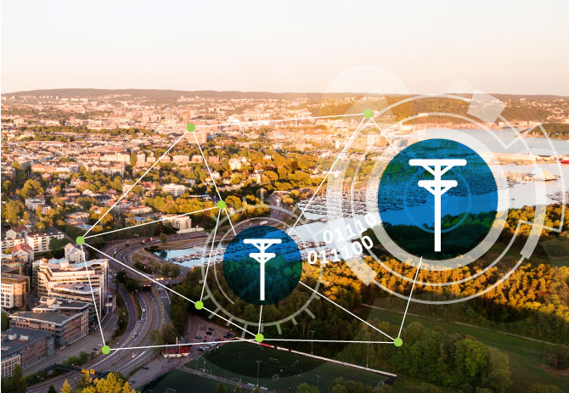
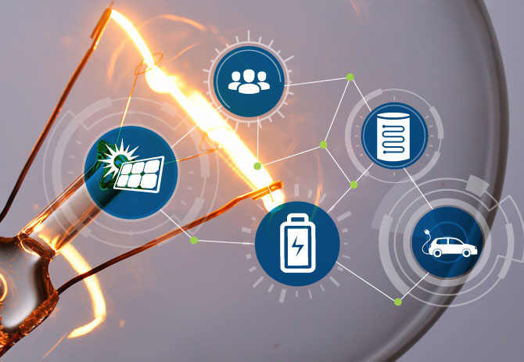
Research areas
Smart grid development and asset management
Microgrids/ Local Energy Communities
Smart grid operation
Interaction DSO/TSO
Flexible resources in the power system
Smart grid scenarios and transition strategies

Slide 11
Pilot projects supporting the research – in four thematic areas
Fault handling and self-healing
Sensing and digital monitoring
Application of AMR/grid data
Flexibility

Slide 12
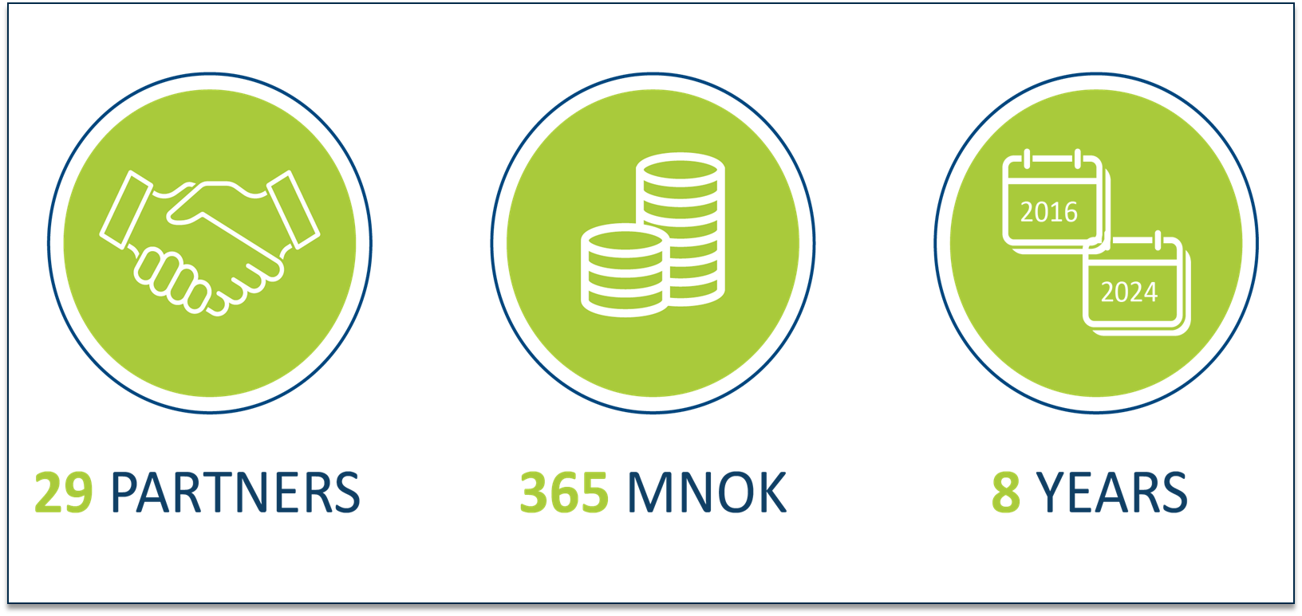
CINELDI in figures
30 PARTNERS 369 MNOK 8 YEARS

Slide 13
CINELDI partners
Research institutes/ University
Authorities (Regulators)
Knowledge transfer
Market operator
Innovation
System operators DSO/TSO
Technology providers
International collaborating partners

Slide 14
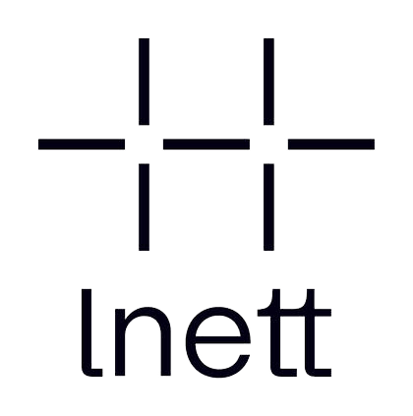
National partners
Ke p

Slide 15
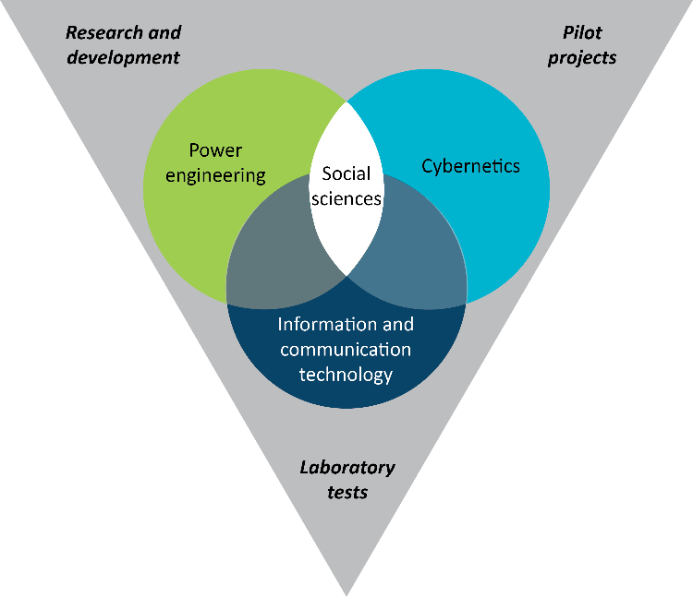
Multidisciplinary research platform
CINELDI targets
system innovation
System innovation should be perceived as a co-evolution of technical, social, economic and regulatory change.

Slide 16
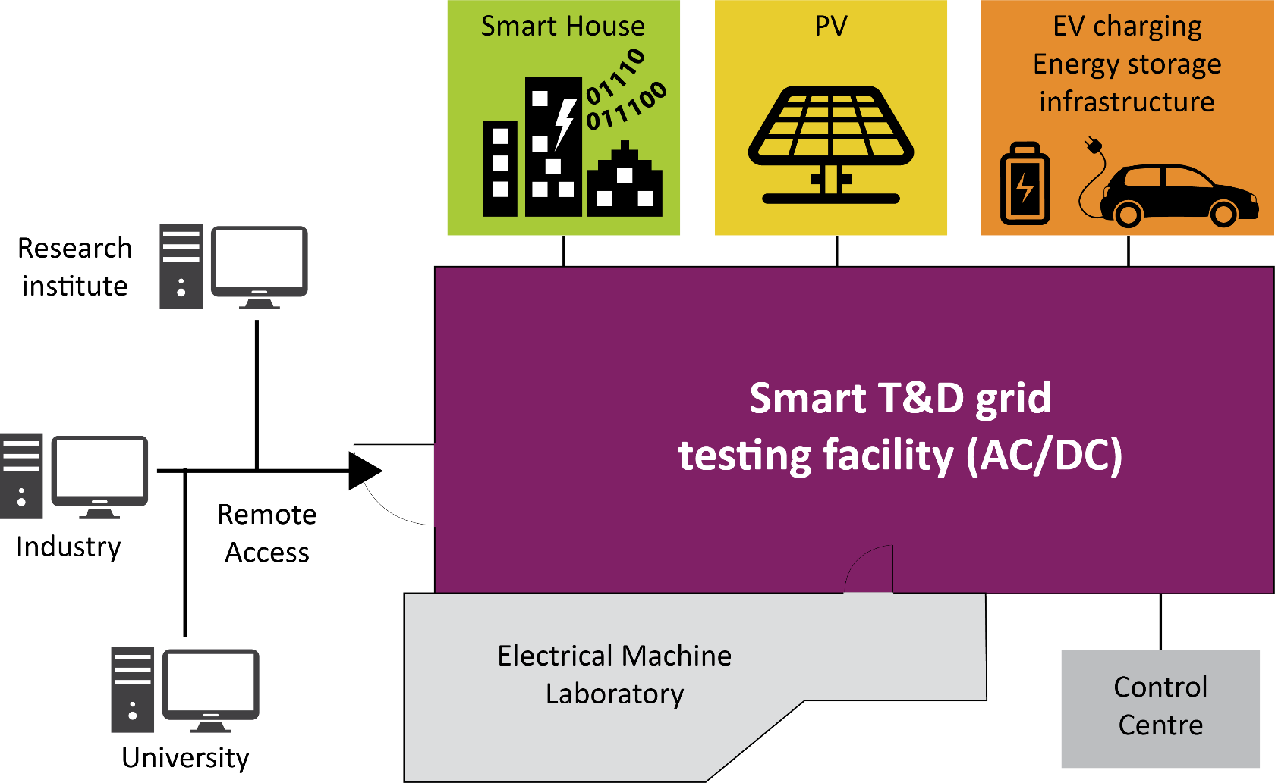
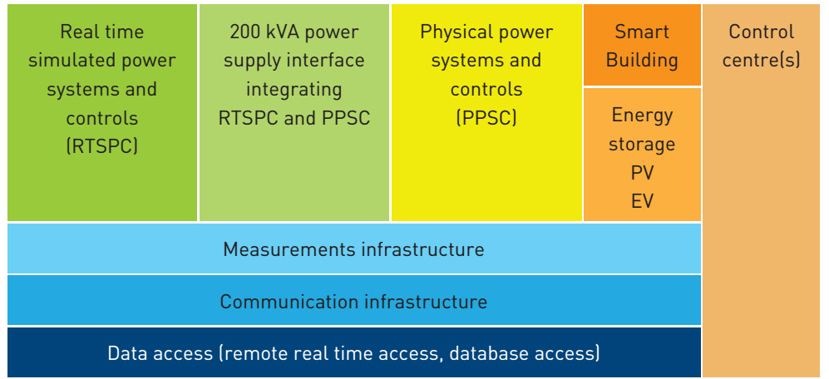
The National Smart Grid Laboratory - an important asset in CINELDI
https://www.ntnu.edu/smartgrid

Slide 17
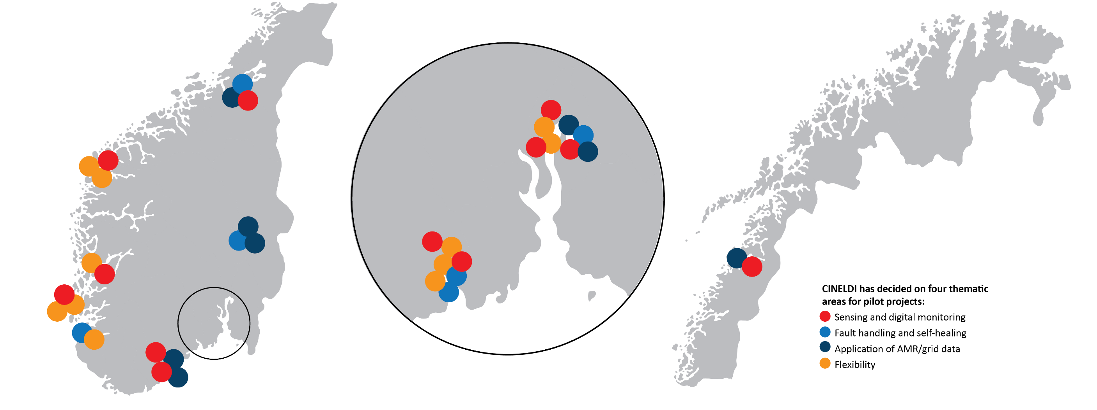
… as well as smart grid pilot projects and living labs

Slide 18
Work packages
Smart grid scenarios and transition strategies
Smart grid development and asset management
Smart grid operation
WP1
WP2
Flexibility and interaction DSO/TSO
WP6
WP3
Pilot projects – WP Pilot

Slide 19
Pilot projects in four thematic areas
Smart grid development and asset management
Smart grid operation
Flexibility and Interaction DSO/TSO
(WP1)
(WP2)
(WP3)
Fault handling and self-healing
Sensing and digital monitoring
Application of AMR/grid data
Flexibility
Smart grid scenarios and transition strategies (WP6)

Slide 20
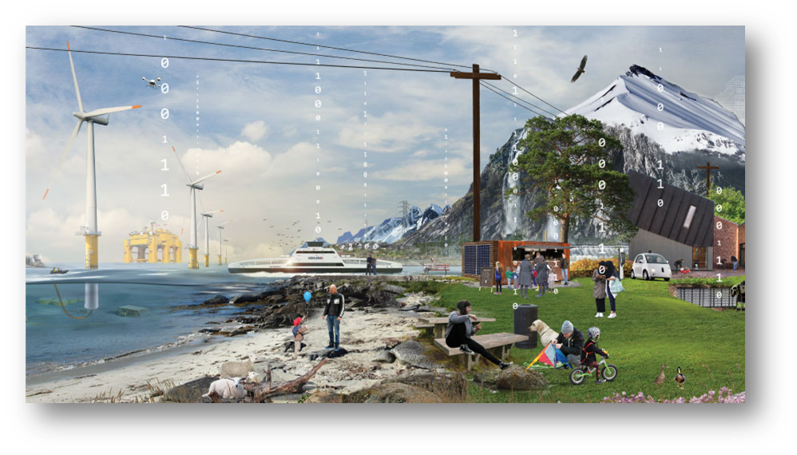
Researcher training and recruitment
CINELDI recruits masters, PhDs and Post doctors in the following disciplines:
Electric power engineering
Communication technology
Information technology
Automation/cybernetics
Socio-economics
Social science aspects of smart grids
NTNU Energy Team Smartgrid
https://www.ntnu.edu/energy/smartgrid
CINELDI targets 20 PhDs/Postdocs and 150 Master projects

Slide 21
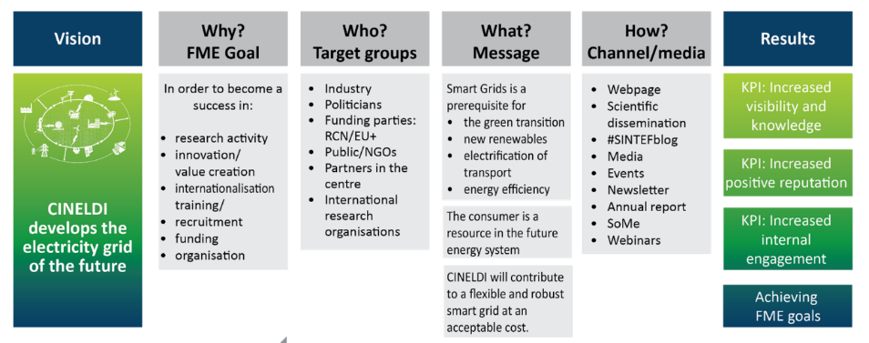
Communication and outreach

Slide 22
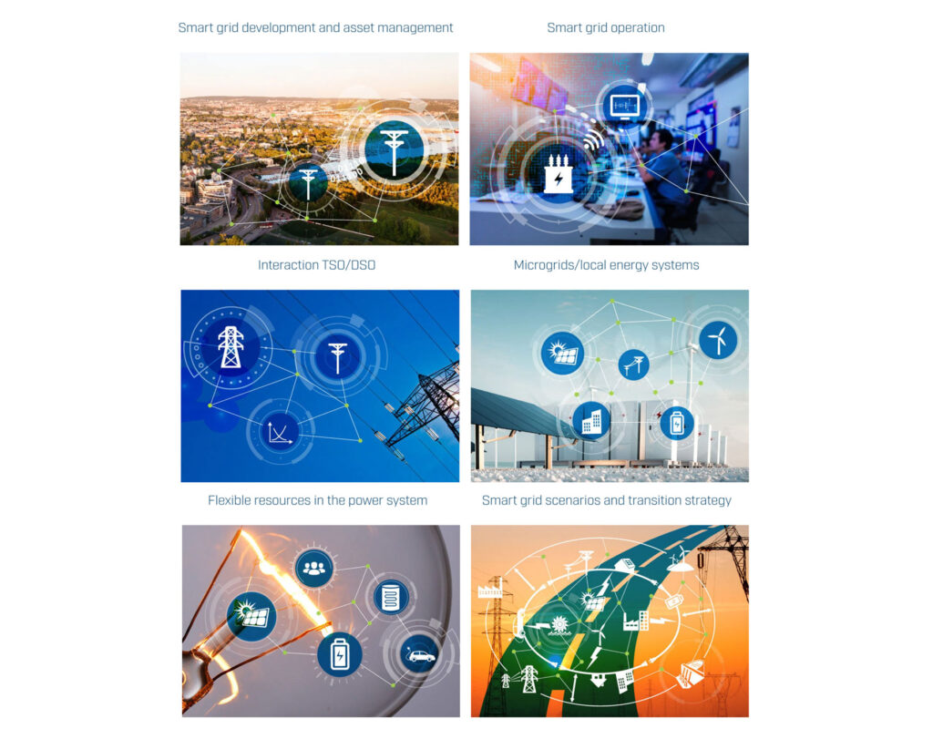
CINELDIs Knowledge base (cineldi.no)

Slide 23
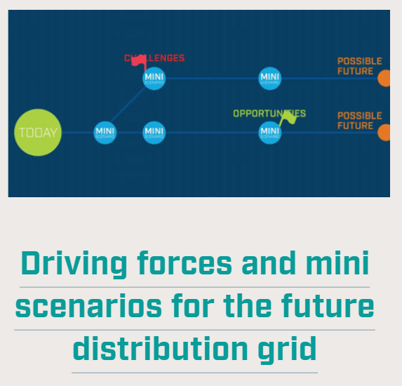
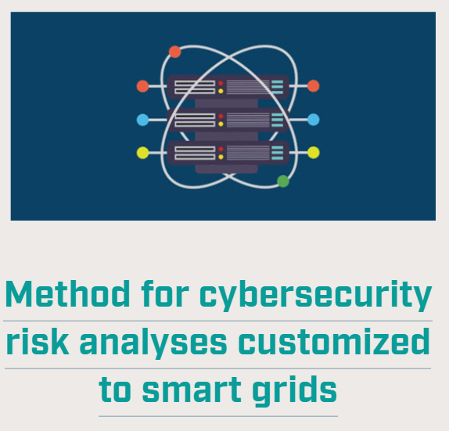
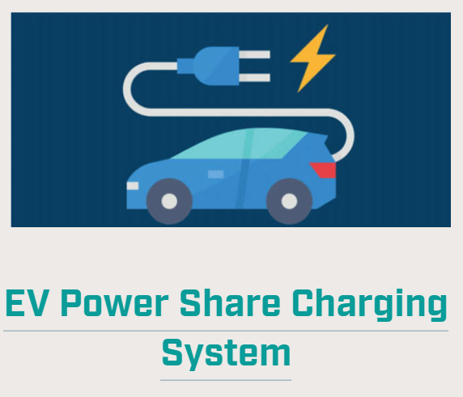
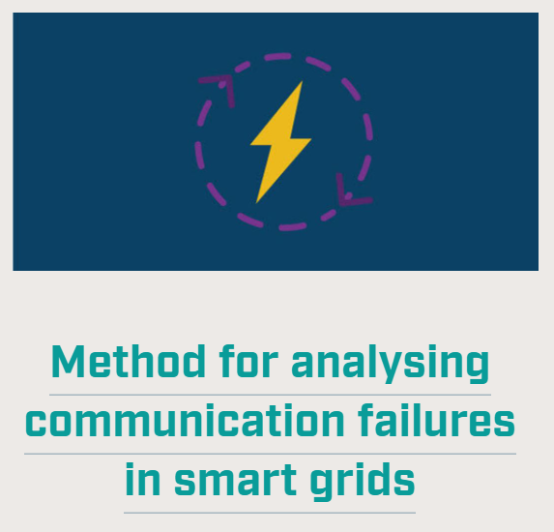
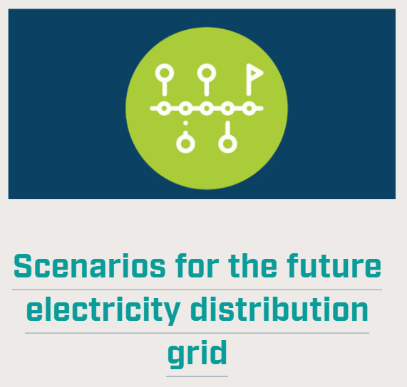
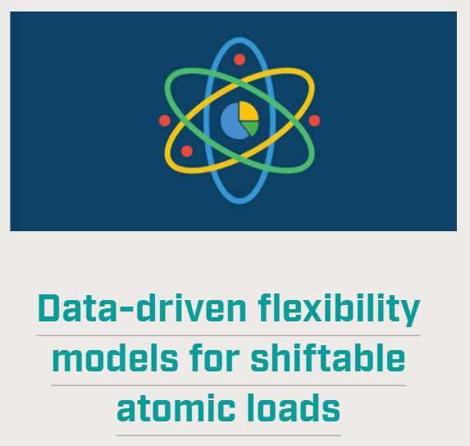
Innovations
Through working with user partners, CINELDI identifies new business opportunities and elevate pilot projects to new national and international spin-off projects.
https://www.sintef.no/projectweb/cineldi/innovation/

Slide 24
www.cineldi.no
This work is funded by CINELDI - Centre for intelligent electricity distribution, an 8 year Research Centre under the FME-scheme (Centre for Environment-friendly Energy Research, 257626/E20). The authors gratefully acknowledge the financial support from the Research Council of Norway and the CINELDI partners.

