Slide 1

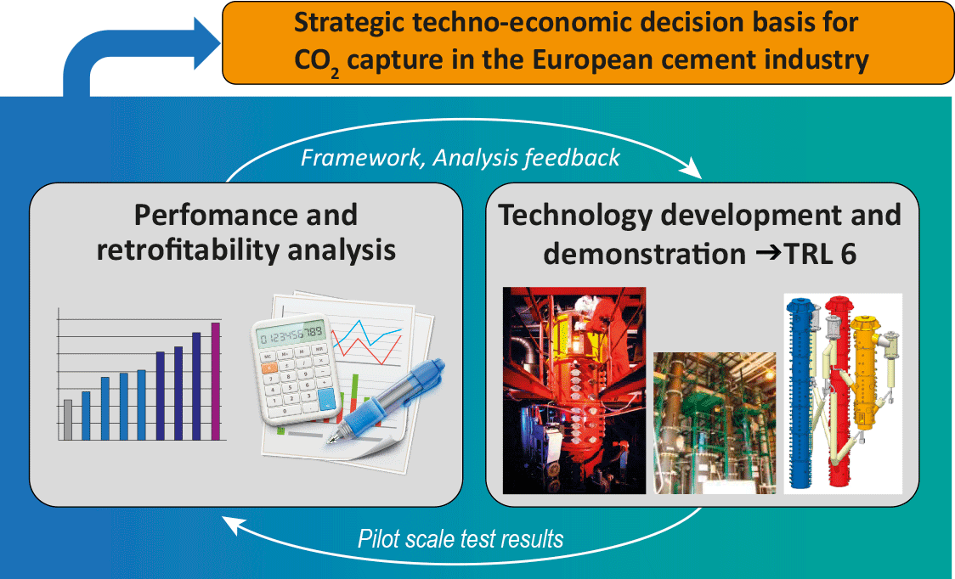
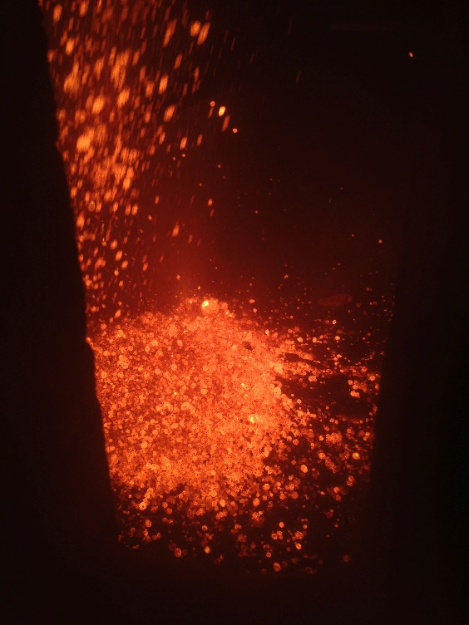
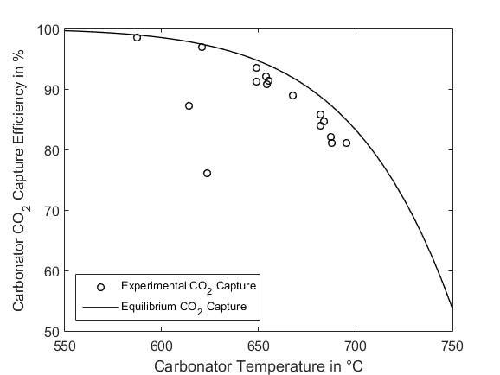

CEMCAP
– retrofittable CO₂ capture for cement plants
CEMCAP is a Horizon 2020 project with the objective to prepare the grounds for cost- and resource-effective CCS in European cement industry.
Main goal:
Prepare the ground for large-scale implementation of CO₂ capture in the European cement industry.
Why CO₂ capture, transport and storage (CCS)?
CO₂ emissions from the cement industry constitute 7-9 % of global anthropogenic CO₂ emissions. CO₂ Capture and Use or Storage (CCUS) provide an opportunity for significantly reducing CO₂ emissions from cement plants, and therewith reduce the cement industry contribution to global warming and climate change.
CEMCAP
The Horizon2020 research project CEMCAP is focusing on making CO₂ capture retrofittable to cement plants. The project aims to:
Consortium:
Three cement producers
Tour technology providers
Eight RD&I providers
The consortium represents seven European countries.
Test technologies under industrially relevant conditions (TRL 6).
Simulate and asses capture technologies at full scale.
Perform retrofitability analysis – a techno-economic decision basis for CO₂ capture from cement plants.
Key figures:
Duration: May 2015 - October 2018
Budget: 10,030 kEUR
EC contribution: 8,779 kEUR
Swiss government funding: 704 kEUR
Industrial funding: 547 kEUR
Coordinator: SINTEF Energy Research
Technologies
Oxyfuel capture:
Testing of a calciner under oxyfuel conditions in a 20kW rig.
Testing of oxyfuel combustion for cement plant conditions in a 500 kW rig.
Testing of an oxyfuel clinker cooler prototype on site at a HeidelbergCement plant in Hannover, Germany (Figure 1). The tests are conducted and the worlds first clinker has been produced under oxyfuel conditions!
Kristin Jordal¹, Sigmund Størset¹, Matthias Hornberger², Simon Becker³, Giovanni Cinti⁴, Johannes Ruppert5, Reinhold Spörl²
¹SINTEF Energy Research, Trondheim, Norway
²Institute of Combustion and Power Plant Technology (IFK), University of Stuttgart, Stuttgart, Germany
³IKN GmbH, Neustadt, Germany
⁴Italcementi, Bergamo, Italy
⁵VDZ gGmbH, Düsseldorf, Germany
Contact: Kristin Jordal
kristin.jordal@sintef.no
www.sintef.no/cemcap
Twitter: @CEMCAP_CO2
Figure 1. Hot commissioning of the oxyfuel clinker cooler prototype.
Post-combustion capture:
Chilled Ammonia Process (CAP): Testing of the CAP absorber, direct contact cooler and water wash.
Membrane-assisted CO₂ liquefaction (MAL): Testing of commercial CO₂-selective polymeric membranes and subsequent liquefaction of CO₂.
Calcium looping (CaL): Testing of fluidized bed and entrained flow processes. Results are shown in Figure 2.
This project is funded by the European Union's Horizon 2020 Framework Programme for research and innovation
Figure 2. Experimental results on CaL CO₂ capture efficency versus equilibirum CO₂ capture.
"The Future of Cement, 200 years after Louis Vicat", 6-8 June 2017, UNESCO, Paris

