Slide 1
M. Spinelli, E. De Lena, M. Gatti, R. Scaccabarozzi, S. Campanari, S. Consonni, M.C. Romano – Politecnico di Milano G. Cinti – Italcementi 14th International Conference on Greenhouse Gas Control Technologies, GHGT-14 October 2018, Melbourne, Australia
Techno-economic analysis of Calcium Looping processes for low CO₂ emission cement plants

Slide 2
Summary
Why Calcium-looping in cement plants
Integration options of Calcium-looping in Cement plants
Tail-end CaL configuration
Integrated CaL configuration
Key performance indicators
Results
Conclusions

Slide 3
Why Calcium-Looping
CO₂-rich gas to sequestration
CO₂-lean flue gas
CARBONATION
CaO+CO₂→CaCO₃
~ 650ºC
CALCINATION
CaCO₃→CaO+CO₂
~ 900ºC
CaCO₃
Heat
O₂
fuel
CaO
Flue gas (CO₂)
CaCO₃
make-up
CaO purge
Sorbent originates from CaCO₃ which is a raw material for clinker production
CaO purge can be used in clinker production

Slide 4
Tail-end CaL configuration
Carbonator removes CO₂ from cement plant flue gas → highly suitable for retrofit
CaO-rich purge from CaL calciner used as feed for the cement kiln
CFB CaL reactors: d₅₀=100-250 μm
Particles for clinker production d₅₀=10-20 μm
→ CaL purge milled in the raw mill at low temperature

Slide 5
Fluidized bed carbonator for Tail-end CaL configuration
Fluidized bed CaL process for cement plants demonstrated at CSIC and University of Stuttgart up to TRL6
The CaL design parameters for cement plant applications are in good agreement with the design parameters for power plant operation.
Arias et al., 2017. CO₂ Capture by CaL at Relevant Conditions for Cement Plants: Experimental Testing in a 30 kW Pilot Plant. Ind. Eng. Chem. Res., 56, 2634–2640.
Hornberger et al., 2017. CaL for CO₂ Capture in Cement Plants – Pilot Scale Test. Energy Procedia, 114, 6171–6174.

Slide 6
Integrated CaL configuration
CaL carbonator integrated in the preheater, treats the rotary kiln gas only
CaL calciner coincides with the cement kiln pre-calciner
Calcined raw meal as CO₂ sorbent in the carbonator
Sorbent has small particle size (d₅₀=10-20 μm) → entrained flow reactors

Slide 7
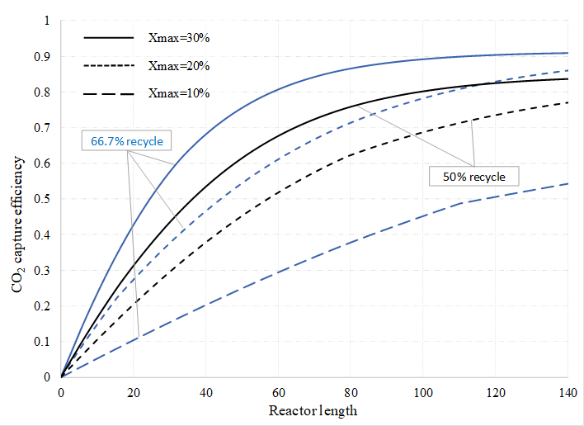
Entrained flow carbonator for integrated CaL configuration
1D carbonator modelling showed possibility of achieving high capture efficiency with solids/gas ratio of ~10 kg/Nm³.
Belite formation in calciner may cause a decrease of the sorbent CO₂ carrying capacity → controlled calcination conditions needed.
Demonstration of chemistry and fluid-dynamics of the reactors in industrially relevant conditions needed
Visit the Cleanker poster!
Spinelli et al., 2018. One-dimensional model of entrained-flow carbonator for CO₂ capture in cement kilns by calcium looping process. Chemical Engineering Science, 191, 100-114.
Alonso et al., 2018. Capacities of Cement Raw Meals in Calcium Looping Systems. Energy & Fuels, 31, 13955–13962.

Slide 8
Heat recovery steam cycle
CaL process involves additional fuel consumption.
Excess heat recovered at high temperature by steam cycle.
The resulting steam cycle size is:
~70 MW_{e} in the tail-end case
~20 MW_{e} in the integrated case
Steam cycle parameters:
60-100 bar
460-530°C
Steam turbine η_{is}=76-86%
1-2 feed water heaters
Integrated CaL steam cycle
→ Steam cycle electric efficiency = 30-36%

Slide 9
Key Performance Indicators
Equivalent primary energy consumption:
Equivalent CO₂ emissions:
Specific primary energy consumption:
Direct fuel consumption
Indirect fuel consumption (η_{ref,el} = 45.9%)
Direct emissions
Indirect emissions (e_{ref,el}=262 kg/MWh)
Equivalent fuel consumption of reference cement plant without capture
Equivalent emissions of reference cement plant without capture

Slide 10
Results: mass and energy balance
 | Cement plant w/o capture | Tail-end CaL (20% integration) | Tail-end CaL (50% integration) | Integrated CaL
Carbonator CO₂ capture efficiency [%] | -- | 88.8 | 90.0 | 82.0
Total fuel consumption [MJ_{LHV}/t_{clk}] | 3240 | 8720 | 7100 | 5440
Rotary kiln fuel consumption [MJ_{LHV}/t_{clk}] | 1230 | 1220 | 1220 | 1150
Pre-calciner fuel consumpt. [MJ_{LHV}/t_{clk}] | 2010 | 1550 | 850 | 4290
CaL calciner fuel consumpt. [MJ_{LHV}/t_{clk}] | -- | 5950 | 5040
ASU electric consumption [kWh/t_{cem}] | -- | 85 | 73 | 62
CPU electric consumption [kWh/t_{cem}] | -- | 110 | 101 | 89
Steam turbine production [kWh/t_{cem}] | -- | 413 | 260 | 150
Other auxiliaries consumption [kWh/t_{cem}] | 97 | 137 | 128 | 116
Net electricity consumpt. [kWh_{el}/ t_{cem}] | 97 | -81 | 42 | 117
Direct CO₂ emissions [kg_{CO2}/t_{clk}] | 865 | 119 | 79 | 55
Indirect CO₂ emissions [kg_{CO2}/t_{clk}] | 35 | -29 | 15 | 46
Equivalent CO₂ emissions [kg_{CO2}/t_{clk}] | 900 | 90 | 94 | 101
Equivalent CO₂ avoided [%] | -- | 90.0 | 89.5 | 88.8
SPECCA [MJ_{LHV}/kg_{CO2}] | -- | 4.42 | 4.07 | 3.16
De Lena et al., 2017. Process integration of tail-end CaL in cement plants. Int J Greenh Gas Control. 67, 71-92.

Slide 11
Results: economic analysis
Cost of CO₂ avoided mainly associated to Capex:
De Lena et al. Techno-economic analysis of Calcium Looping processes for low CO₂ emission cement plants. Submitted to Int J Greenh Gas Cont.

Slide 12
Results: economic analysis
Cost of cement vs. Carbon tax:
Integrated CaL plant
Tail-end CaL plant
Cement kiln w/o capture
De Lena et al. Techno-economic analysis of Calcium Looping processes for low CO₂ emission cement plants. Submitted to Int J Greenh Gas Cont.

Slide 13
Conclusions
Ca-LOOPING PROCESS INTEGRATION OPTIONS:
Post-combustion capture configuration:
Low uncertainty in the technical feasibility
Very high CO₂ capture expected
Two calciners are present in the system, leading to high fuel consumptions
Integrated CaL configuration:
High CO₂ capture efficiency without modifying rotary kiln operation (no need of kiln oxyfiring).
Higher thermal efficiency and lower fuel consumptions
New carbonator design and fluid-dynamic regime: fluid-dynamics, heat management and sorbent performance need validation
Competitive cost of CO₂ avoided.
We have ideas on how to reduce Capex and Opex of the integrated CaL system to be explored in Cleanker project

Slide 14
Thank you
Contact: matteo.romano@polimi.it
www.gecos.polimi.it
This project has received funding from the European Union's Horizon 2020 research and innovation programme under grant agreement no 641185.
https://www.sintef.no/projectweb/cemcap/

