Slide 1
FlexBuild
Optimal utilisation of flexibility in buildings
Karen Byskov Lindberg, PhD
Marius Bagle
Igor Sartori, PhD
SINTEF Community
CITIES workshop, 12 Aug 2020, Copenhagen (virtual)
Notes:
Hvilken verdi har sluttbrukerfleksibilitet for kraftsystemet?
Hvordan kan varmepumper og elbillading bidra til økt fleksibilitet?
Sluttbrukerfleksibilitet – en verdi for kraftsystemet?
Sluttbrukerfleksibilitet = smart styring av varmepumper og elbiler

Slide 2
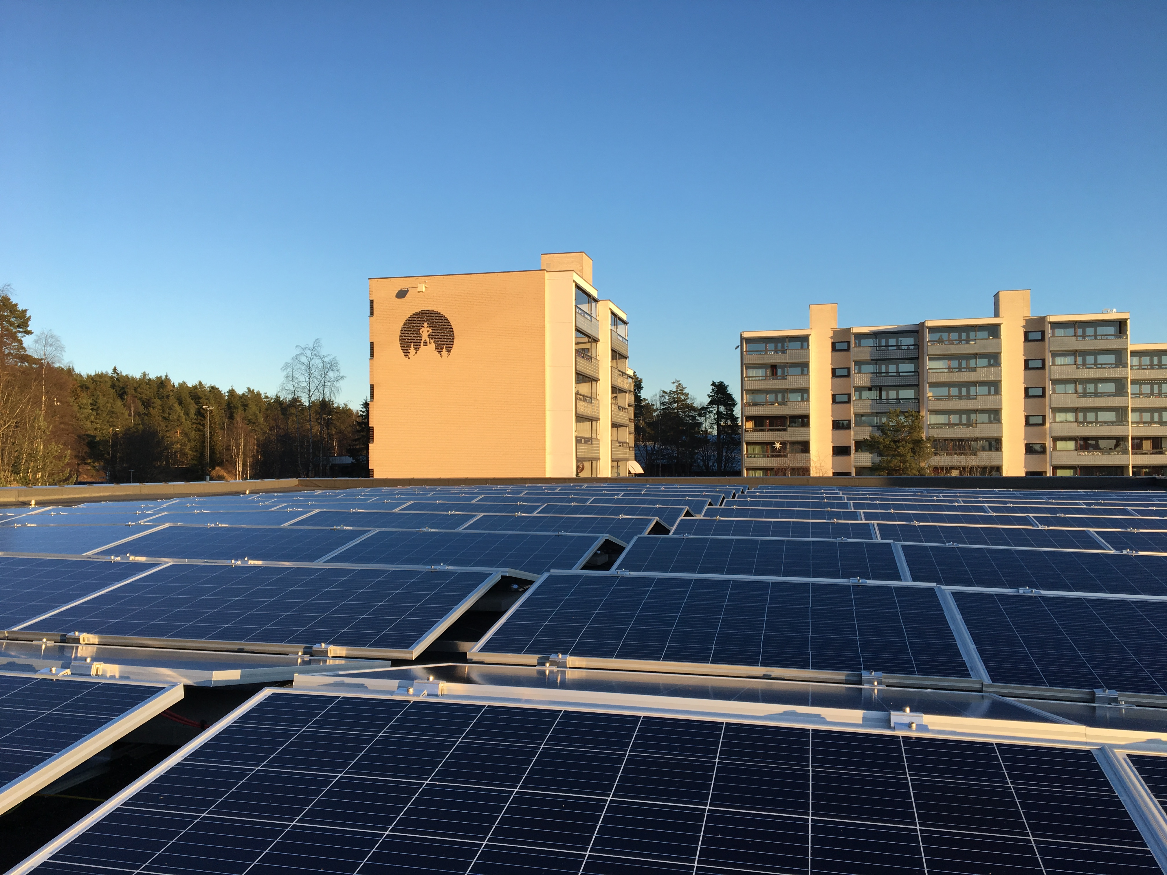
FLEXBUILD
The value of end-use flexibility in the future Norwegian energy system
Evaluate the role of local flexibility interacting with the power system and district heating system
Project owner: SINTEF
Duration: 4 years
Budget: 16.6 mill kr
Industrial branch / Partners
Building owners Statsbygg, Omsorgsbygg, TOBB
District heating companies Norges Fjernvarmeforening
Grid companies Statnett, Elvia
Public actors NVE, Enova
Research institutes SINTEF, IFE, NTNU, SINTEF Energi

Slide 3
The models and their integration
BUTLER: Building sector
TIMES-Norway: Energy system
EMPIRE: European power system
EMPS/FanSi: Norwegian hydropower system
Utilise the strength of each model for better decision support
1st year: prepare modelling tools for integration

Slide 4
BUTLER
BUTLER – flexibility at building level
  MILP model with hourly time resolution
  Minimising total cost over 40 years
Source: Lindberg et al., 2016. Methodology for optimal energy system design for Zero Energy Buildings using mixed-integer linear programming. Energy and Buildings, Vol. 127, pp. 194-205
Notes:
BUilding's opTimaL Energy design and opeRation

Slide 5
Electricity use in Norway and Denmark
Industry
Buildings
  Heat demand
  Electric spec. demand
Transport
  EVs
Incentives for utilising flexibility
  Denmark: increase utilisation of wind and solar
  Norway: reduce peak load
Space heating
Space heating
Power intensive industry
Electric appl., fans & pumps, lights
Notes:
I Energimeldingen anslo NVE at store kraftbrukere (industri og petroleum) hadde en effektbruk på rundt 5.5 GW. Av et samlet maksforbruk på 24,5 GW i sentralnettet januar 2016. Dersom alle planer blir gjennomført kan dette øke opp mot 7 GW mot 2030. Det et Nettbas som er kildene til disse dataene.

Slide 6
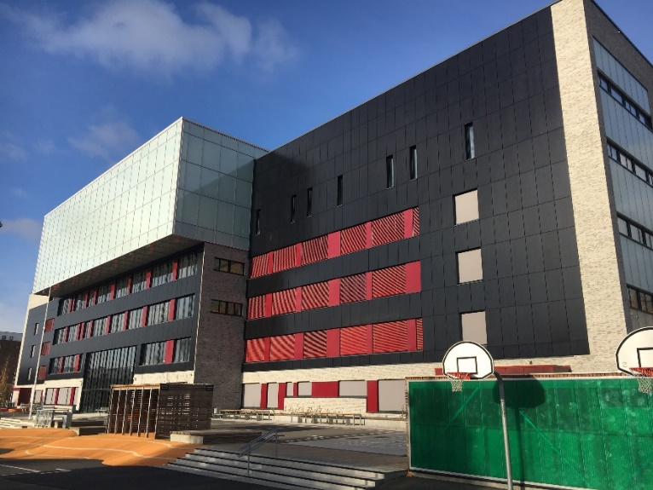
Reduce peak load
Norwegian energy authorities
  New incentives for reducing peak load
    Energy labelling of buildings
    Grid tariffs
FlexBuild, 1st year
  Investigating the impact of new grid tariffs on the peak load
  Assuming all data-driven technologies are in place
  All buildings are operated in a least-cost way
Photo by Lisa Kvalbein

Slide 7
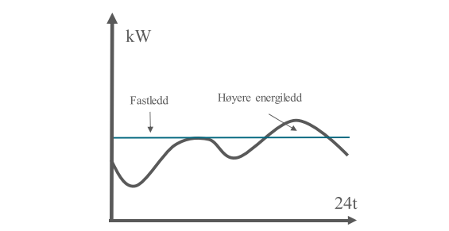
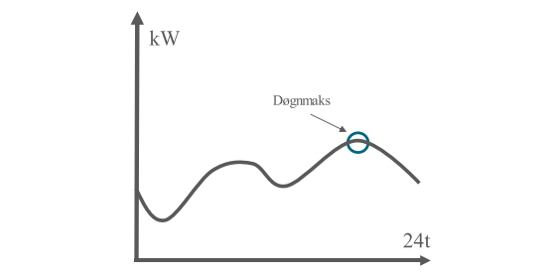
New grid tariffs analysed
Subscription tariff
Daily peak load tariff
 | Fixed costs | Energy price | Peak price
 | EUR/year | cent/kWh | cent/kWh/hr
Energy tariff | 118 EUR | 4.6
Subscription tariff | 135 EUR + 67.5 EUR/kW | 0.5 | 8
Daily peak tariff | 185 EUR | 0.5 | 18 (w) 12 (s)
Monthly peak tariff | 404 EUR | 0.69 (w) 0.39(s) | 1490 (w) 790 (i) 230(s)
current
Payment for hours above subscription limit
new
new
One payment per day
current
One payment per month
Notes:
Hvem gjelder effekttariffen for?
Ved ordinær overføring og lavspenning tilknytning gjelder effektavregningen alle anlegg med hovedsikring over 125 A ved 230 volts nett, og alle anlegg over 80 A ved 400 volts nett. I tillegg gjelder effektavregningen for alle anlegg med forventet årsforbruk over 100 000 kWh. Ved ordinær overføring og høyspenning tilknytning avregnes alle anlegg etter effekttariff.

Slide 8
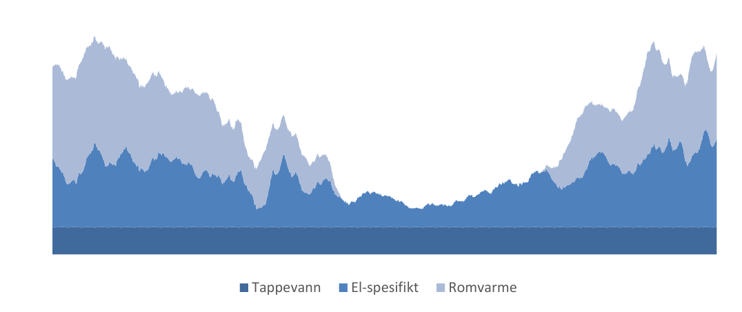


Single Family Home 250 m²
SFH from the 70-80-ies
Energy demand: 41 800 kWh/år
  Heat: 31 200 kWh/yr
  Electric spec.: 10 600 kWh/yr
3 use cases
regular
ELECTR. RADIATOR
regular
HEAT PUMP
efficient
HEAT PUMP

Slide 9
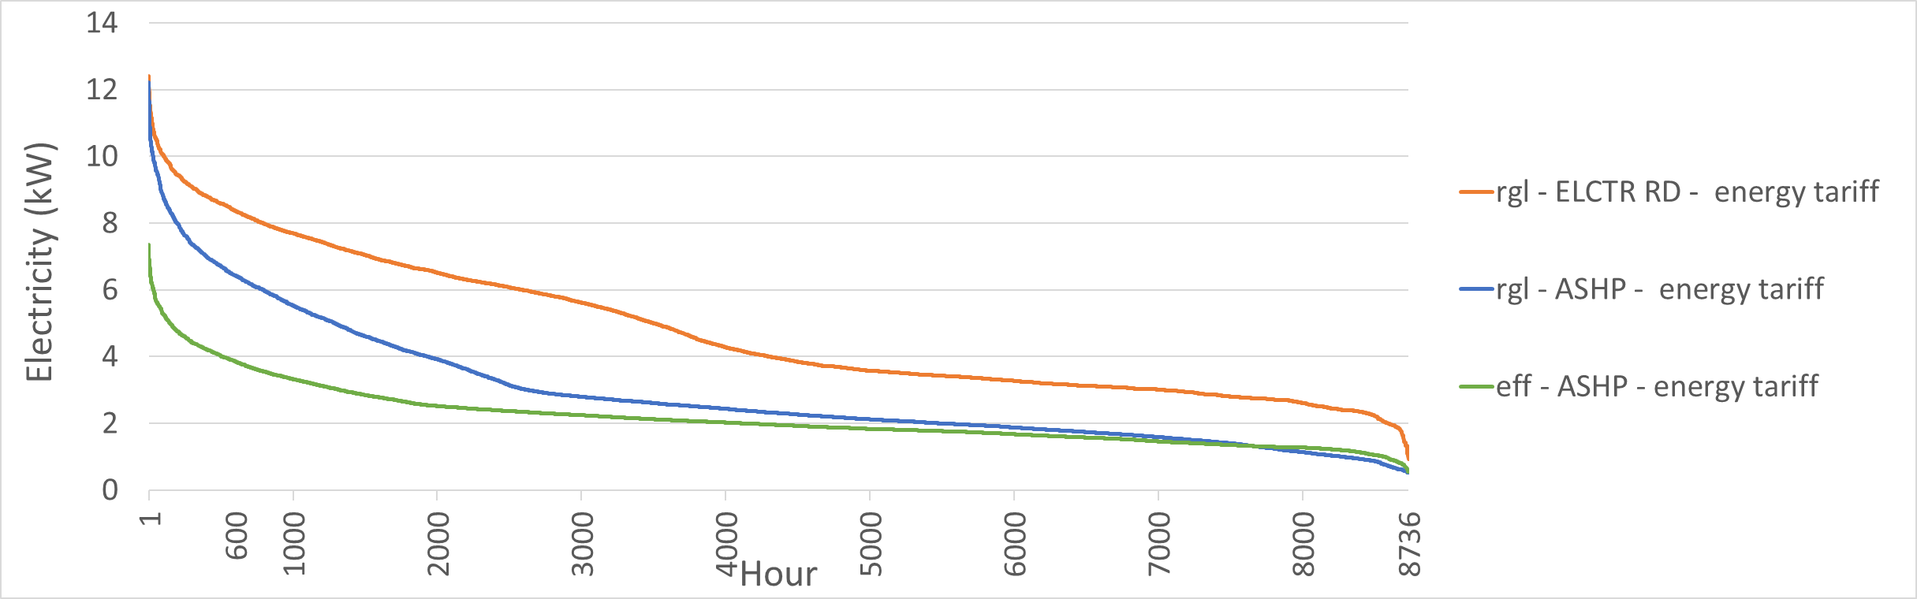
Electricity load with energy tariff
- 1%
- 41%

Slide 10
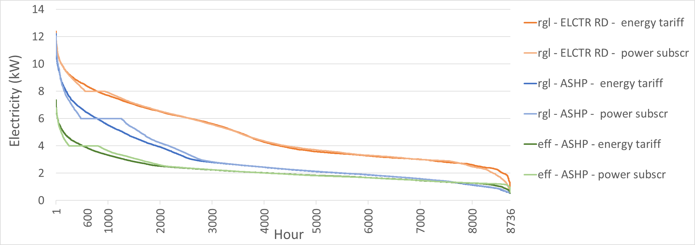
Subscription tariff
8 kW
6 kW
4 kW

Slide 11
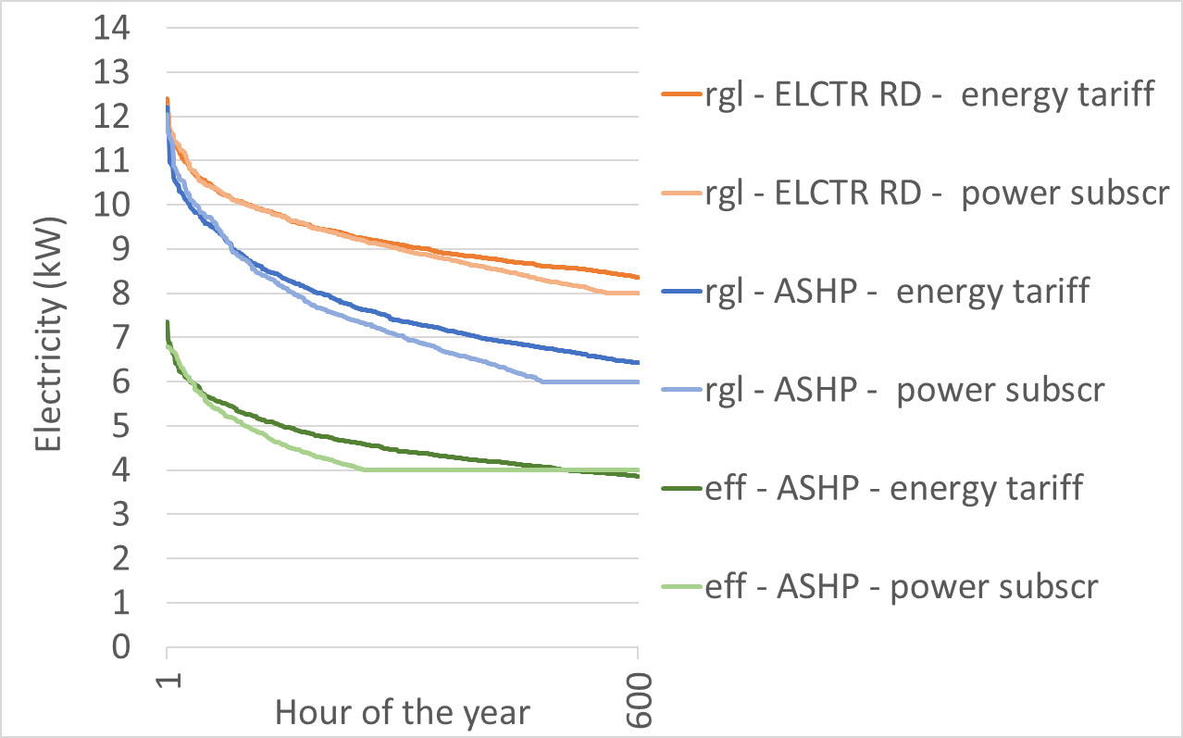
Subscription tariff
- 1%
- 1%
- 3%
- 41%
- 45%

Slide 12
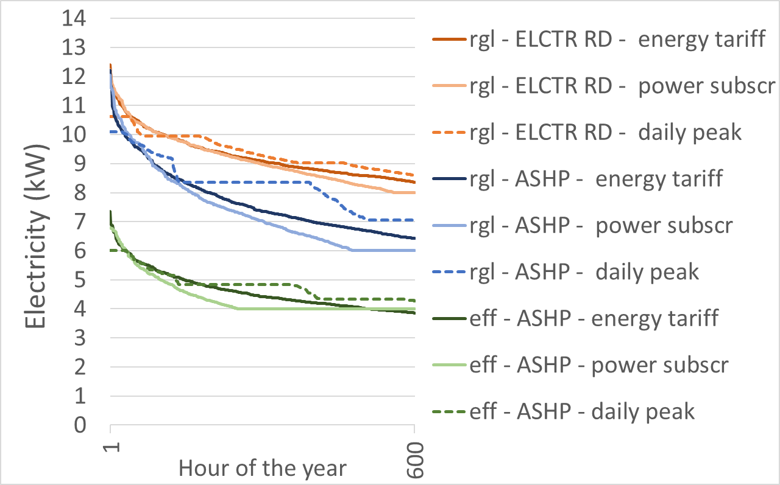
Daily peak power
- 1%
- 14%
- 1%
- 3%
- 18%
- 41%
- 45%
- 51%

Slide 13
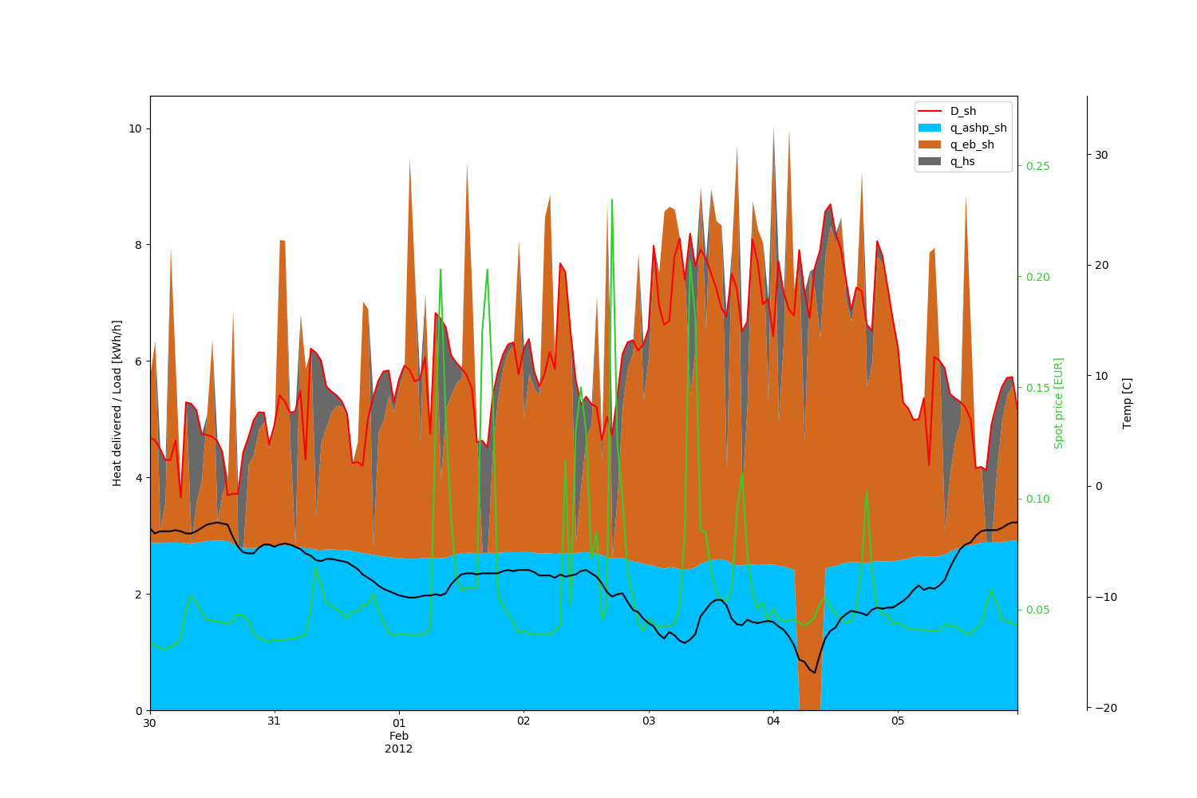
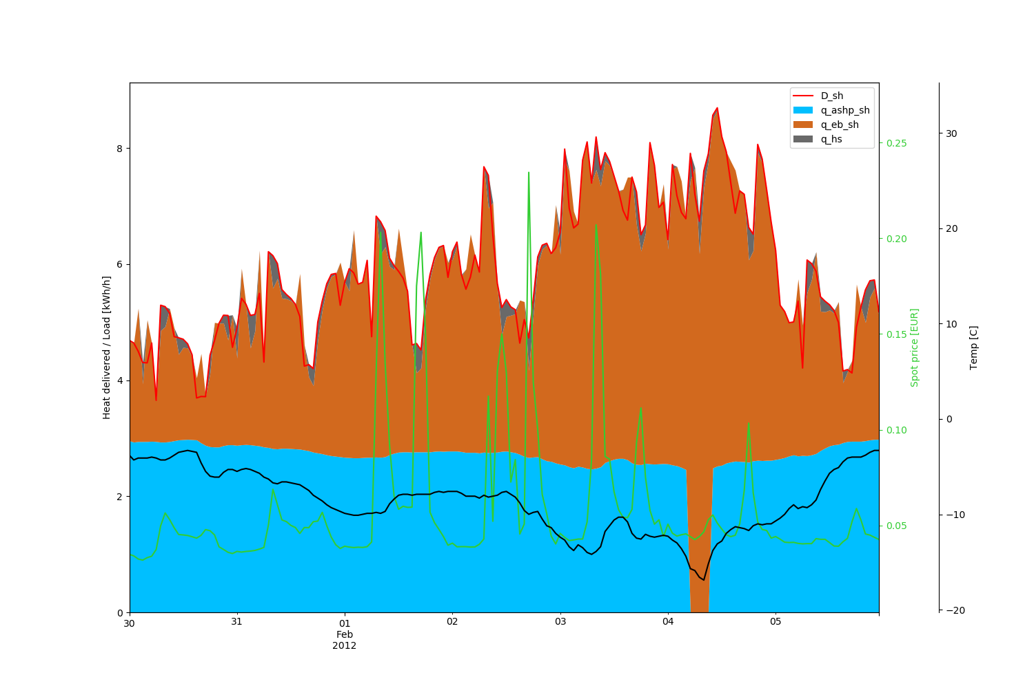
What happens on the coldest day?
Waterborne heating & ASHP
Subscription tariff
Daily peak tariff
10
30
0,25
8
30
8
0,25
20
Heat storage
0,20
20
0,20
6
Heat genereration (kWh/h)
Heat genereration (kWh/h)
6
price
10
0,15
Temp (°C)
10
price
0,15
Temp (°C)
4
4
0
Electr. top-up
0
0,10
0,10
2
2
-10
-10
0,05
0,05
Air-source heat pump (ASHP)
0
-20
0
-20

Slide 14
BUTLER: Results for region NO1
Floor area [mill. m²]
Categories:
Single Family Home (SFH) + Apartment = Residential (RES)
Commercial buildings (COMM)
Technical standard: We only consider regular buildings
Heat distribution system: waterborne and point source
Single Family Home | 99.6
Apartment | 22.9
RESIDENTIAL | 122.6
COMMERCIAL | 42.6
Building category:
Technical standard:
Heat distribution system within building:
Building category (i)
Regular (R)
Efficient
(E)
Waterborne heating system (wb)
Point source heating
(ps)
Waterborne heating system (wb)
Point source heating
(ps)

Slide 15
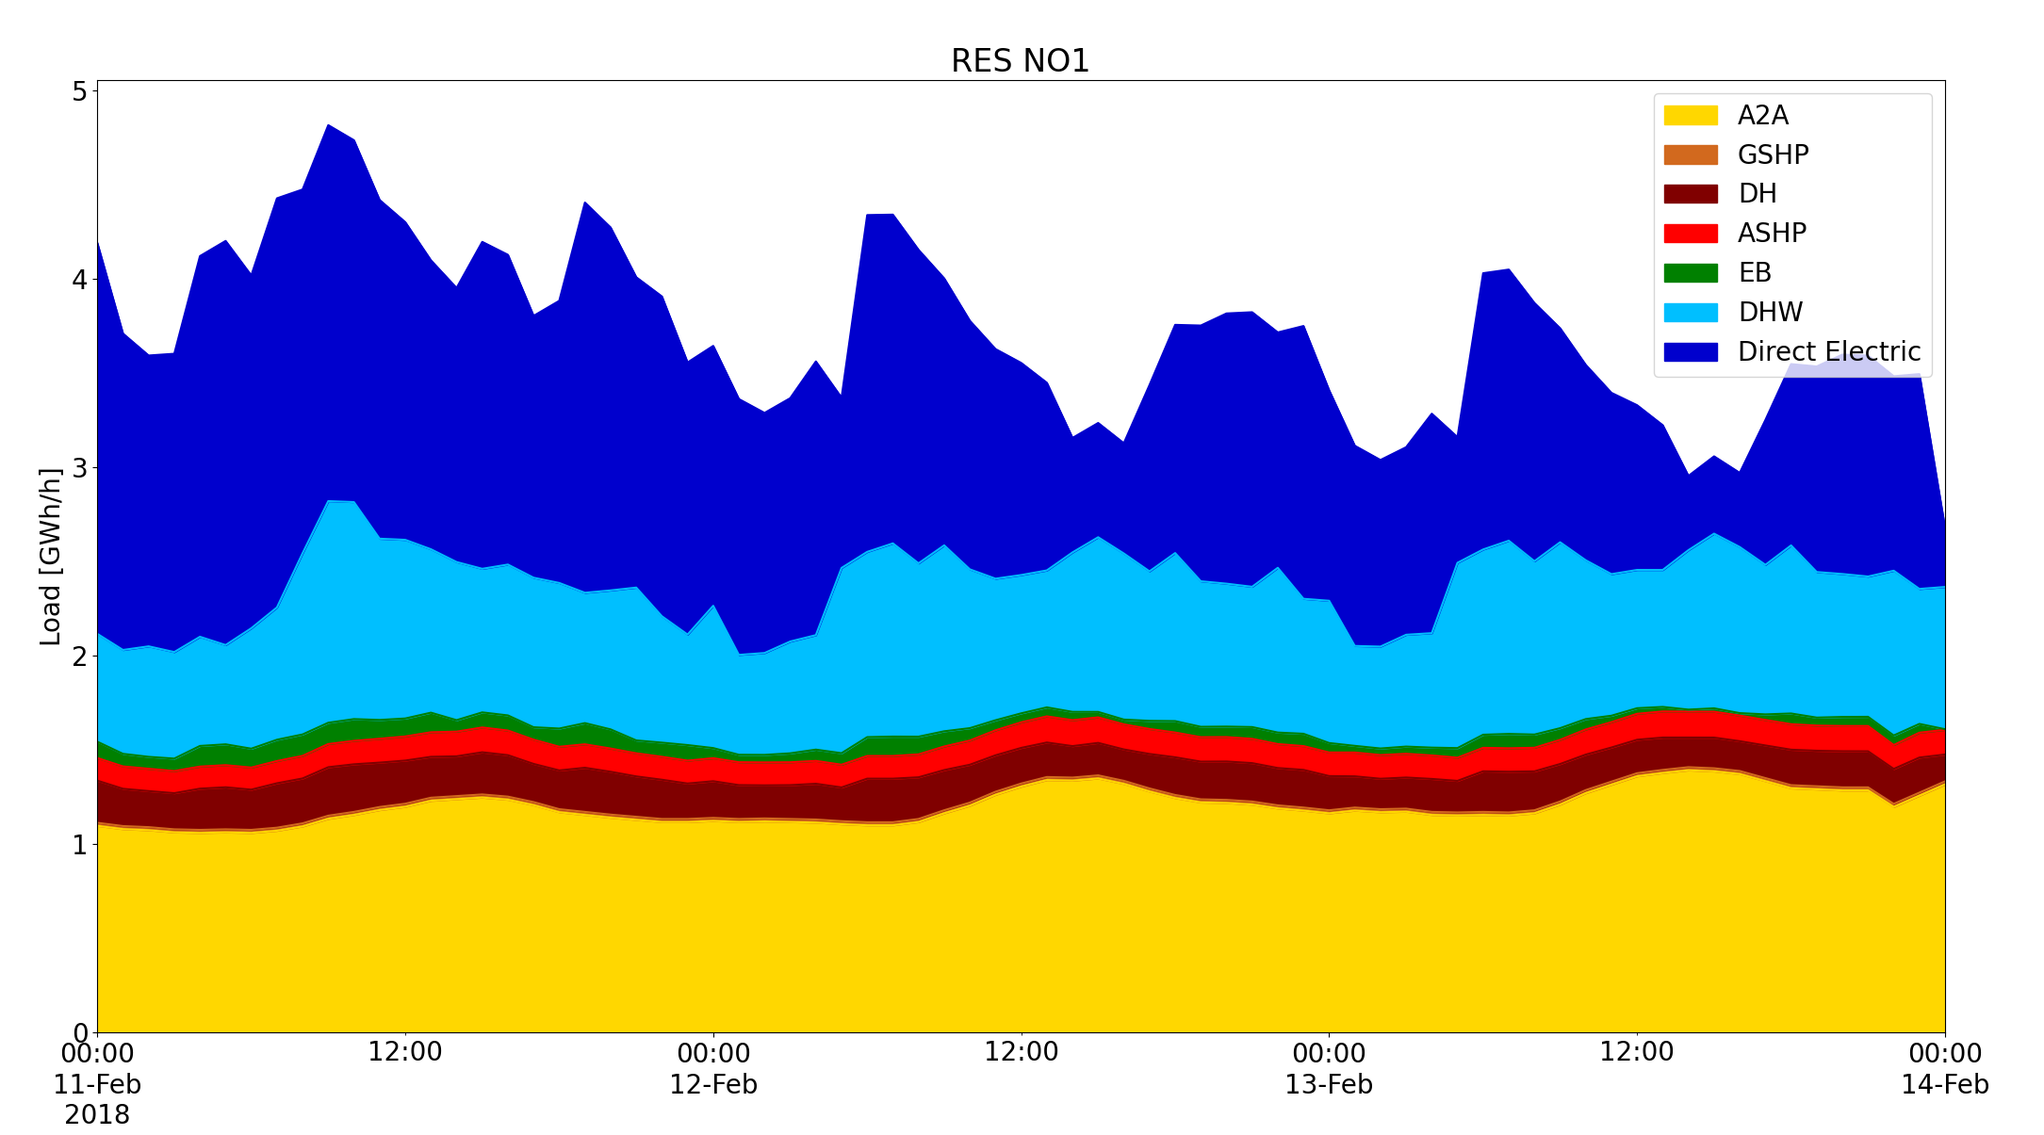
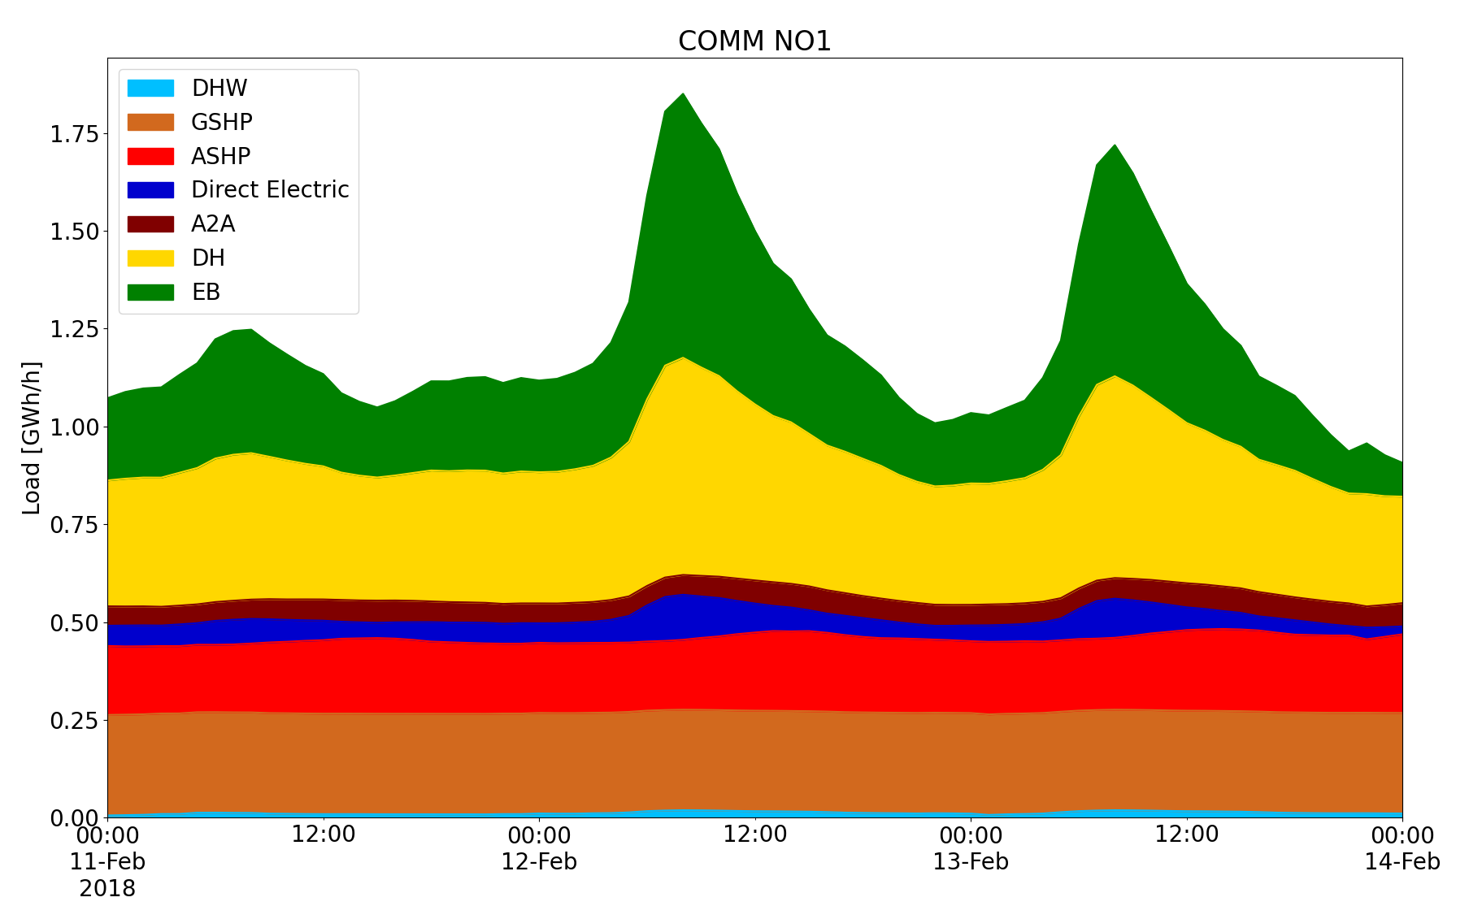
Aggregated heat demand in 2020
Choice of technologies in BUTLER, when using spot prices from TIMES and "energy pricing" grid tariff
3 representative days in winter
Residential sector
Direct electric (panelovner) as peak technology
Commercial sector
Electric Boiler as peak technology

Slide 16
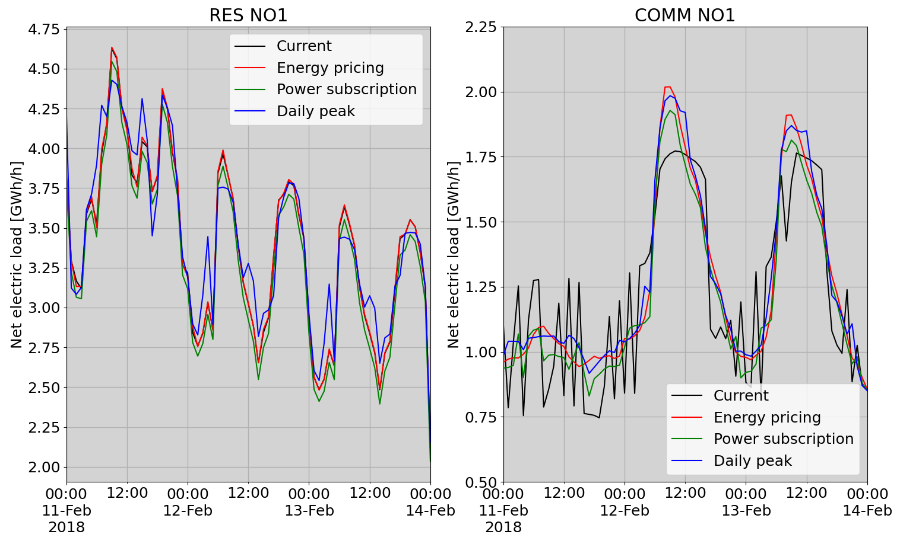
Aggregated electricity load with different grid tariffs
Energy pricing
RESIDENTIAL
COMMERCIAL
Flexibility potential is negative.
Current monthly peak power tariff is most effective.
Flexibility potential from Current to Daily peak:
250 MWh/hr
Monthly peak power tariff

Slide 17


FlexBuild – value of local flexibility for the system
Energy flexibility in buildings
Heating system is essential
Assess how the heat pump and heat storage influences the peak load
Peak load
Occurs on the coldest day
Power tariffs contributes
RESIDENTIAL: daily peak tariff COMMERCIAL: current monthly peak tariff
Large potential in Norway

Slide 19
FLEXBUILD project
The value of end-user flexibility in Norway's future energy system
Norwegian research project (KPN-project)
  Project period: 2019 - 2023
  Budget : 16,6 MNOK (13 MNOK fra NFR)
Research partners
  SINTEF Community, SINTEF Energy, IFE and NTNU
Project partners
  Norsk Fjernvarmeforening, Statsbygg, Omsorgsbygg og TOBB, Statnett og Hafslund Nett, NVE and Enova

Slide 20


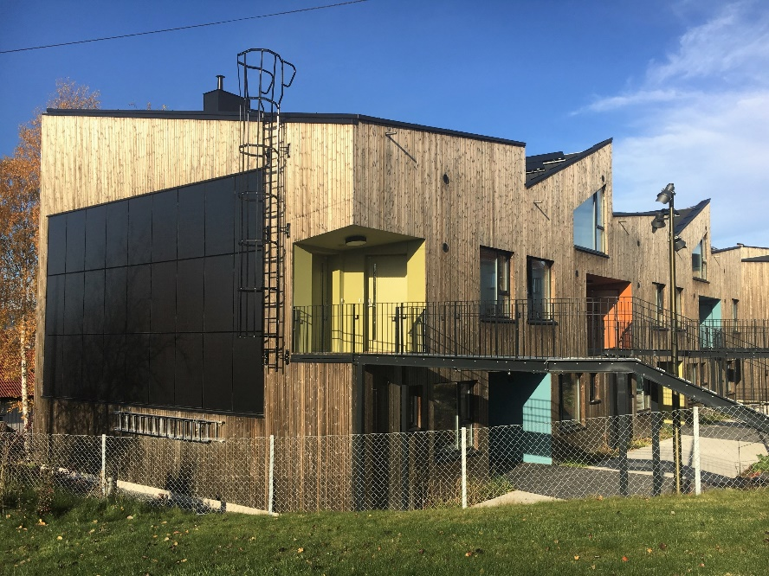
Motivation
  How to utilise the resources in the Norwegian building stock for increased value creation in the energy system?
    Heat technologies – Flexibility services – Local production – Local Storage
Photos by Lisa Kvalbein
Photo by Lisa Kvalbein
Notes:
Are building owners/constructors in line with what is optimal for society?
The NEED for the system: 1. align consumption with available renewable energy, and 2. reduce peak loads or increase the utilization of the existing grid

Slide 21
Hypothesis
The basic hypothesis in FLEXBUILD is that it is necessary to capture the interaction between the energy demand in buildings and the energy system to value the future value of end-use flexibility.
    Heat technologies – Flexibility services – Local production – Local Storage

Slide 22
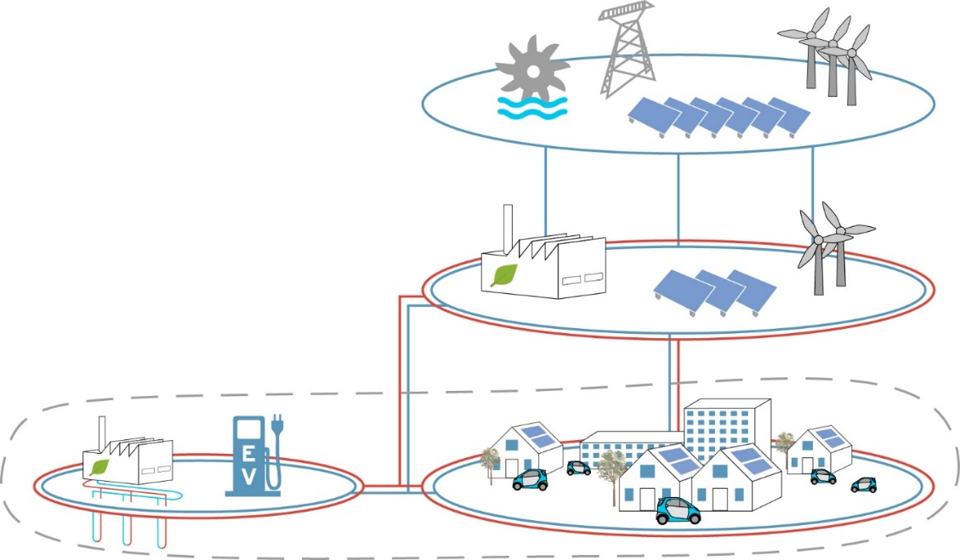
FLEXBUILD
Evaluate the the role of local flexibility interacting with overall energy systems
Energy system
  Generation, distribution and end-use
    buildings, transport and industry
  Interplay and competition between
    Energy carriers
    Technologies
    Flexibility resources
  Low emission society = Integrated energy system
Source figure: FME ZEN

Slide 23
Households
2000
1500
Average load profile
Space heating
1000
Norway
Europe
watt / household
Washing & drying
TV
Lighting
500
PC & accessories
Other
400
TV
Lighting
watt / household
Washing & drying
500
Hot water
300
Other
Refrigeration
200
Lighting
Cooking
100
Refrigeration
Air conditioning
Other
Cooking
0
0
1 3 5 7 9 11 13 15 17 19 21 23
1 3 5 7 9 11 13 15 17 19 21 23
Hour of the day
Hour of the day
Source: SINTEF Energi

Slide 24



Buildings may contribute to the power balance
Wind
Hydro
PV, heat pump, storage
Electricity use
Courtesy to Bjørn Thorud, Multiconsult

Slide 25
Buildings may contribute to the power balance
PV, heat pump, storage
Wind
Hydro
Electricity use
Flexible electricity use
Courtesy to Bjørn Thorud, Multiconsult

Slide 26
How can buildings contribute?
Participate in flexibility markets through an aggregator
Respond to dynamic signals and/or static signals
Must know that the aggregator responds, and that the flex resouce is available
DSO
- congestion management
aggregator
prosumer
3 Non-freq. ancillary services
TSO
These relations are not determined
4 Ancillary services
- frequency - voltage
1 Day-a-head
2 Balancing markets
26
Notes:
Independent aggregators
Will a market for flexibility function independent of the power market?
If they are connected to balancing responsible (today: utilities), then they are binded by their bids/portefoilo that they give in all three «flex-segments»,
So if their flex-resource is tied up in #2, then it is not available for #3.

Slide 27

New grid tariffs
Proposal from the regulator
New structure of the grid tariff
Fixed cost + energy cost + power cost
(EUR/yr) (ct/kWh) (ct/kW)
Power tariff
  Raise awareness among consumers that power peaks are costly
  Fair distribution of grid costs
    (pay for what you use)

Slide 28
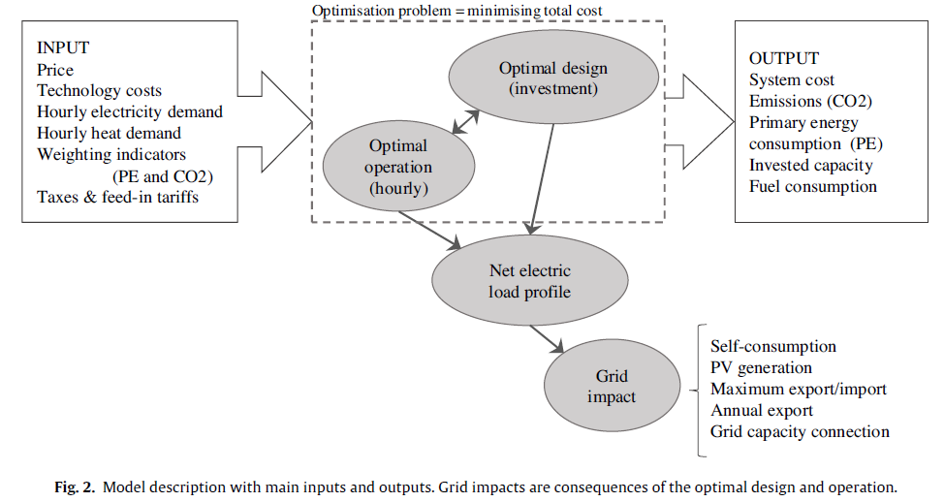

Slide 29
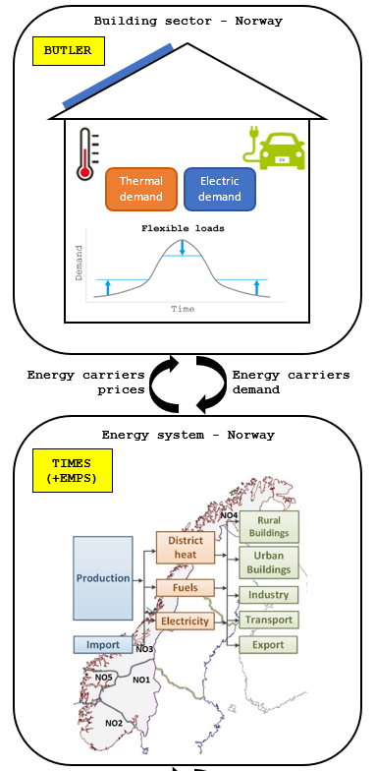
Coupling: TIMES-Norge and BUTLER
The coupling will capture the interaction between the building sector and the energy sector
  What is the cost-optimal development of the building sector from a building owner perspective and from an energy system perspective?
  What level of detail in the building sector is needed to capture the interaction with the energy system?
This has been done so far:
  Harmonised demand profiles: el-specific and heat demand
  Harmonised technology data for the building sector, e.g. % of buildings with waterborne heating
  Electricity and District Heating prices calculated by TIMES-Norge are used as input to BUTLER (one way coupling, no iteration)
Ambition:
  Two-way coupling between the models, with convergence criteria:
    Starting from an initial set of electricity & district heating prices
    BUTLER feeds TIMES with electricity and district heating loads
    TIMES feeds BUTLER with a new set of electricity and district heating prices
    The iteration 1-2 continues until some convergency is achieved

Slide 30
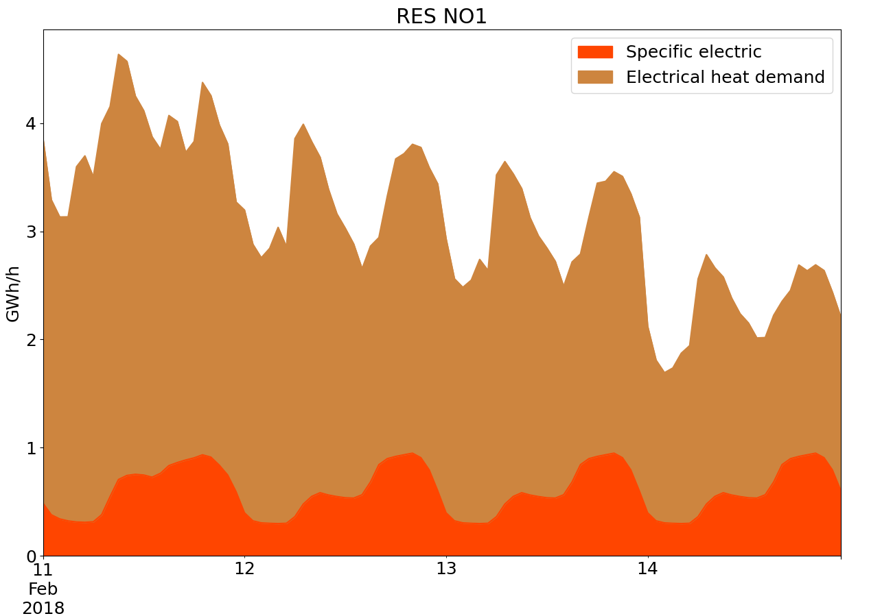
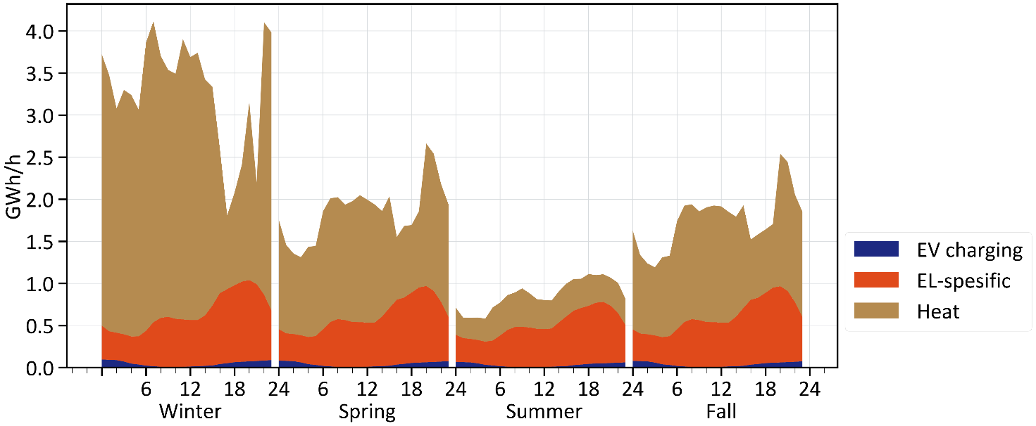
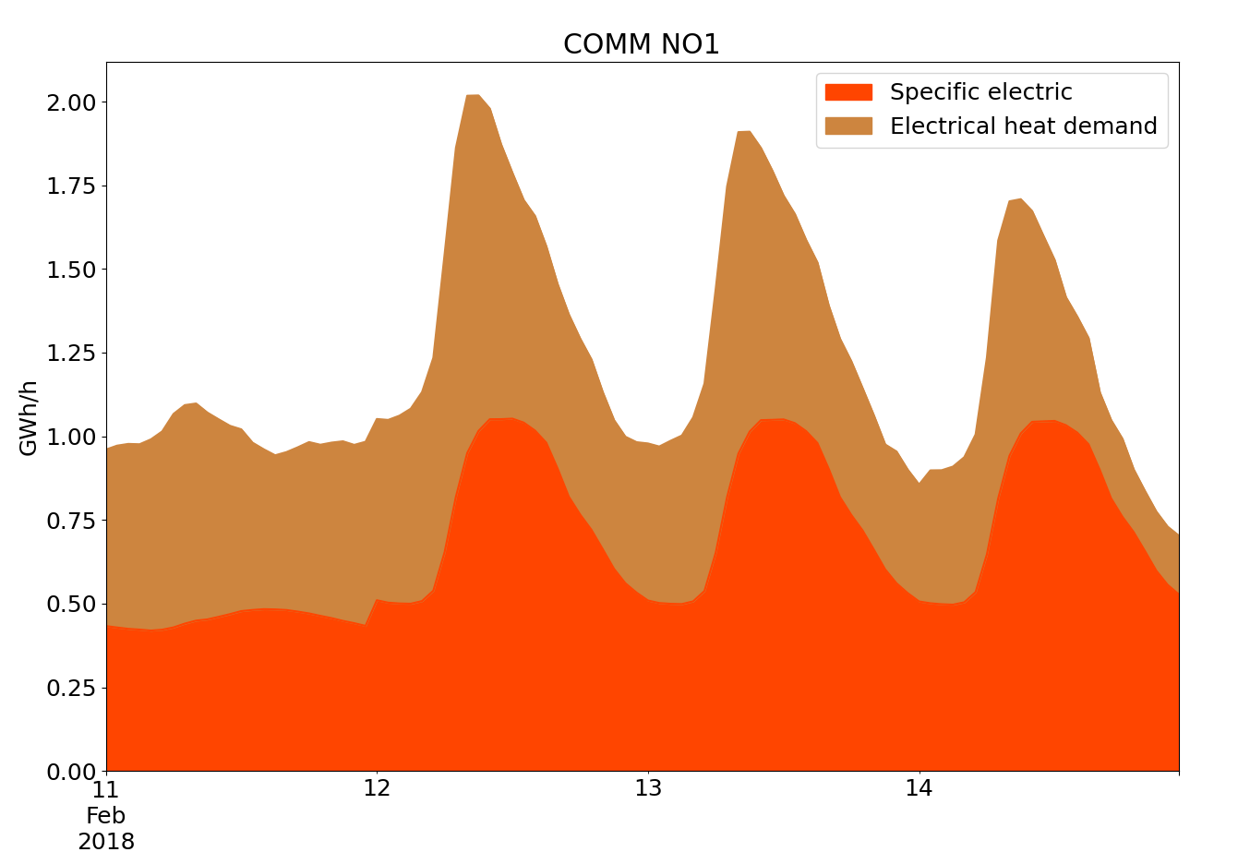
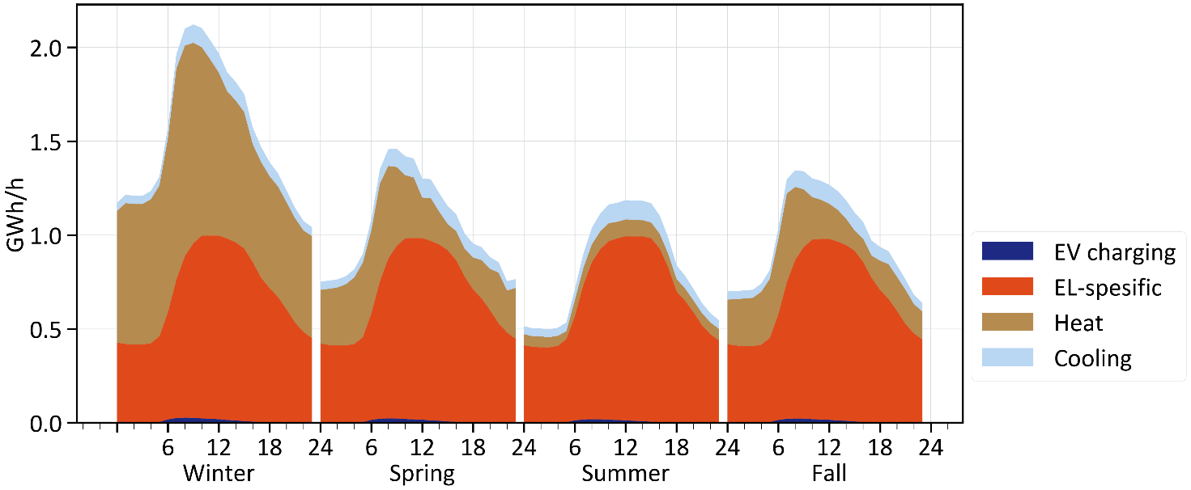
Comparison of BUTLER and TIMES
Aggregated results for region NO1 from the two models in year 2020
BUTLER (3 winter days)
"energy pricing" grid tariff / no EV
TIMES (average day each season)
"Energy nation" storyline
Substantial agreement in starting year, with same grid tariff

Slide 31
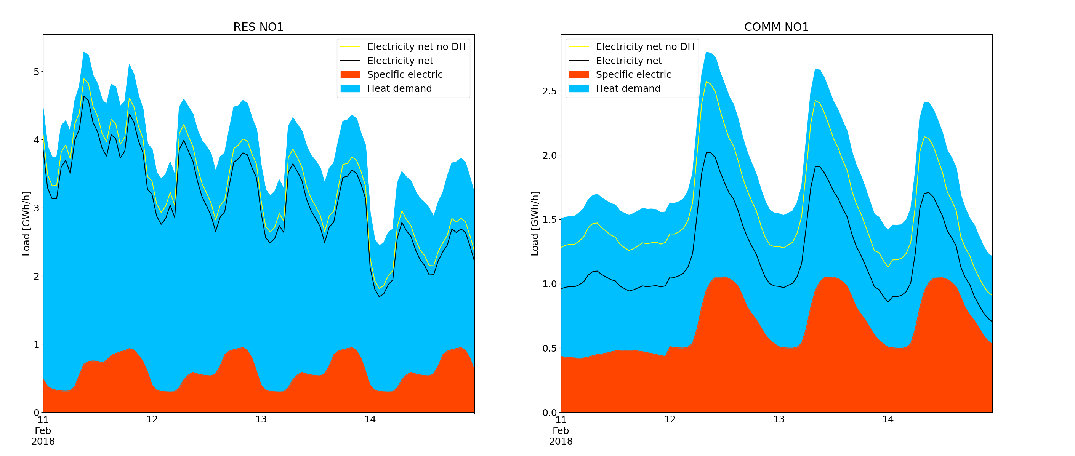
Aggregated electricity load
All heat from panelovner
Colored areas show energy demand (heat + el-specific)
Colored lines show electricity load
Reduction due to heat pumps
Residential sector
Commercial sector
Reduction due to district heating

Slide 32

Summing up
Energy flexibility in buildings
Heating system is essential
Assess how the HP and heat storage influences the peak load
Peak load
Occurs on the coldest day
Power tariffs contributes…
…. however post-insulation and GSHP contribute more

