Slide 1
How to support ATCOs in Dynamic Airspace Configurations Environment ?
Amela Karahasanović, SINTEF

Slide 2
Dynamic Airspace Configurations - DAC
More flexible and efficient ATM systems
Dynamic change of sectorizations adapted to traffic
What about SA and WL?
Change notification
Change implementation
Flightradar24.com
*
FMP activates DAC
ATCO gets aware of the change and explore its impact
ATCO works in the new configuration
The * icon from www.flaticon.com/free-icons/air-traffic-controller" title="air traffic controller icons">Air traffic controller icons created by Shastry - Flaticon
2

Slide 3
Novel design solutions for DAC
3

Slide 4
Sector selector
4

Slide 5
5

Slide 6
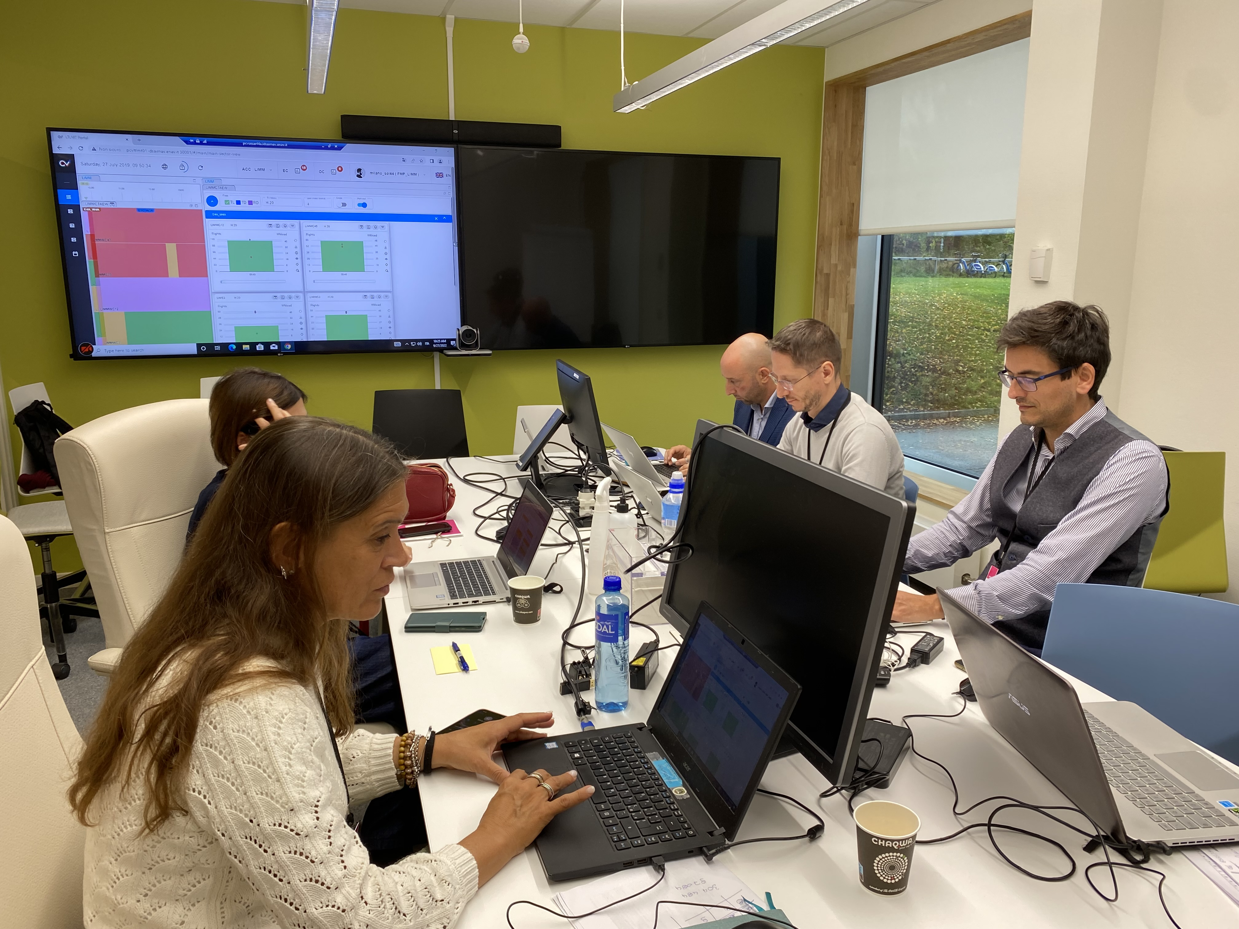
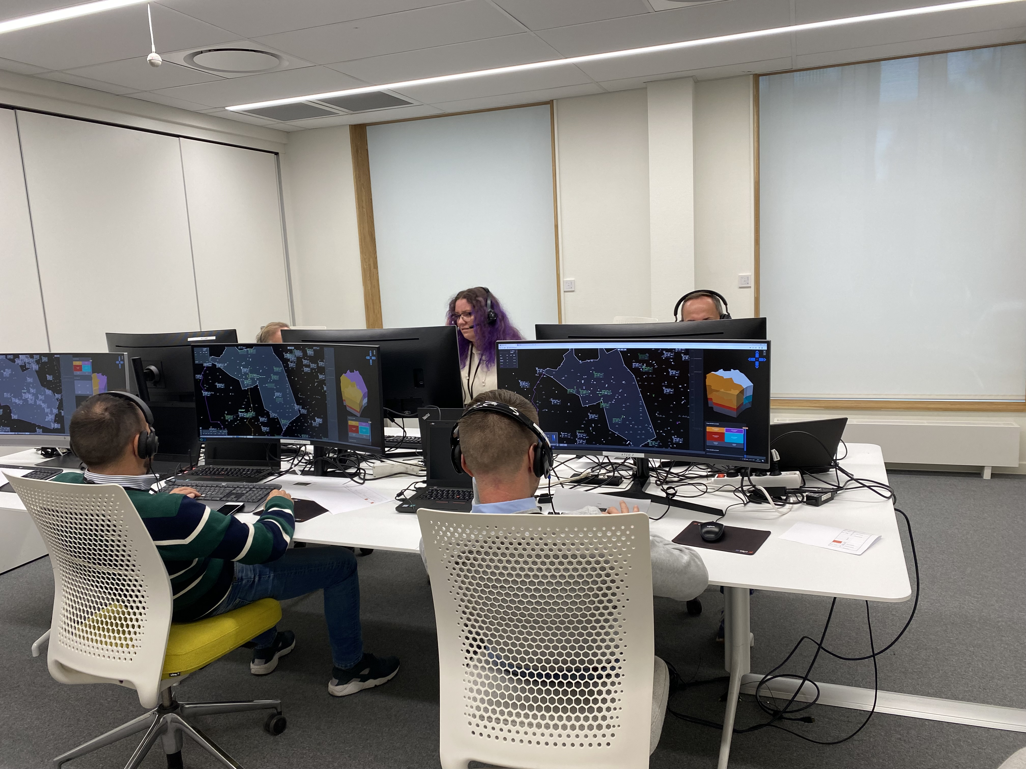
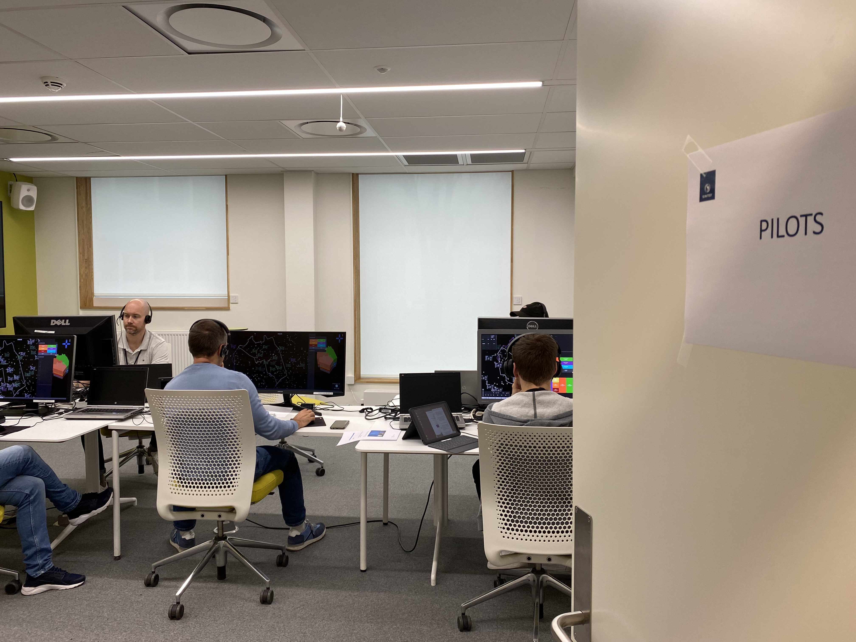
Technical room
VALIDATION IN A NUTSHELL
Real-time simulation; one week
17 ATCOs and FMPs from Italy and Norway
5 platforms from 3 organisations
Questionnaires, interviews, observations, logs
FMPS ROOM
*
*
What
What is happening, before, during and after the change?
FMPS ROOM
ATCOS and PILOTS ROOMS
6
The * icon from www.flaticon.com/free-icons/air-traffic-controller" title="air traffic controller icons">Air traffic controller icons created by Shastry - Flaticon

Slide 7
Visit us at SINTEF booth D3A!
Demo
9th of March 12:00 (walking tour)
10th of March 11:00
Contact:
Amela Karahasanović
Chief Scientist SINTEF Digital
amela@sintef.no
Presentation
This research has been conducted as a part of the projects Digital Network Management Services (PJ.09-W2 DNMS) and Separation Management and Controller Tools (PJ10-W2 PROSA) within the European aviation programme SESAR Joint Undertaking. It has received funding from the SESAR Joint Undertaking (JU) under grant agreements No 874463 and No 874464. The JU receives support from the European Union’s Horizon 2020 research and innovation programme and the SESAR JU members other than the Union. Thanks to the all participants and the project teams at ENAV, IDS AirNav, EUROCONTROL and SINTEF!

